Slide 1
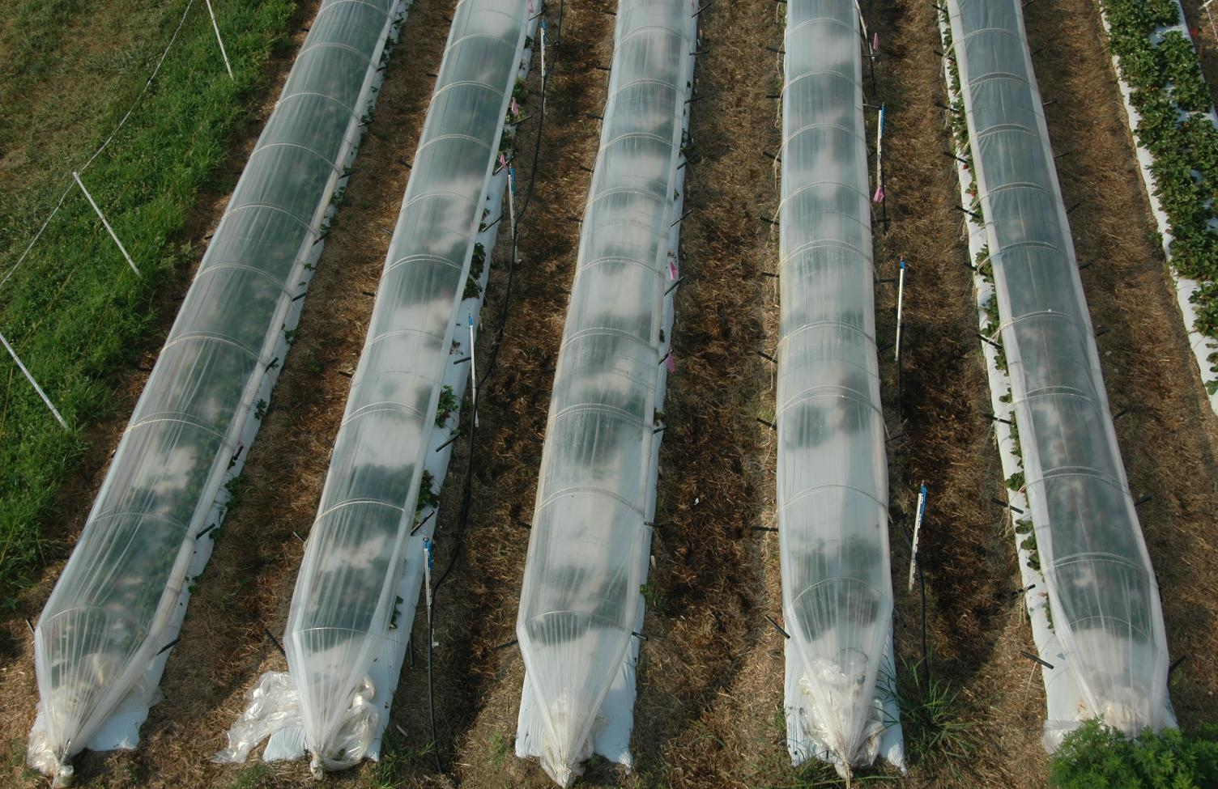
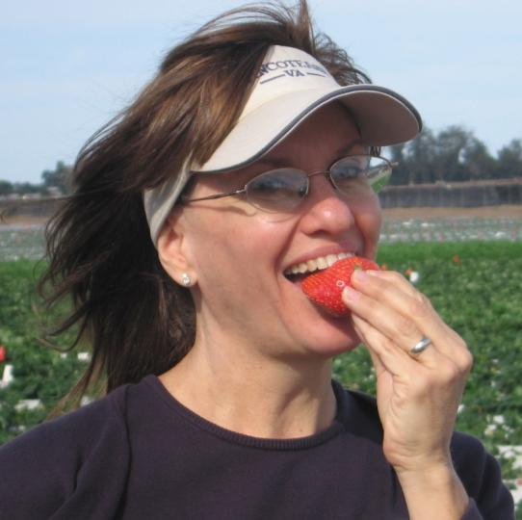
Kim Lewers, USDA-Agricultural Research Service
Beltsville, Maryland
Notes:
My name is Kim Lewers. I am a strawberry breeder and geneticist with the USDA’s Agricultural Research Service. My research fields are in Beltsville, Maryland, just to the northeast of Washington, DC.

Slide 2
February-April
May-September
October-December
Notes:
So this was the idea… Right after planting bare-root dormant plants, the sides are down for warmth. Then in late spring and summer the sides are raised once for ventilation for the summer. Then in the fall, lower the sides once again for the warmth and misters are used for fall frost protection.

Slide 3
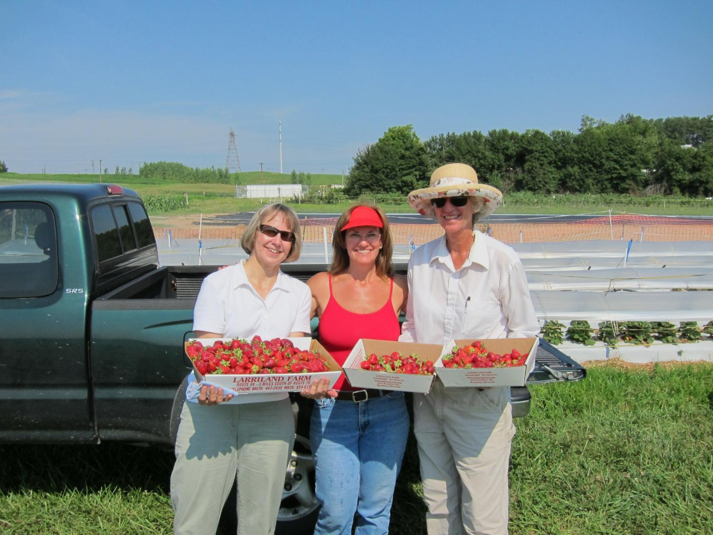
July 2011 - Beltsville, Maryland
First, let’s talk about yield.
Notes:
The results were very surprising. I got a lot of beautiful berries the whole month of July… a whole second month of production. I didn’t understand this… it was so hot… I had heard that the reason dayneutrals wouldn’t produce in Maryland was the heat.

Slide 4
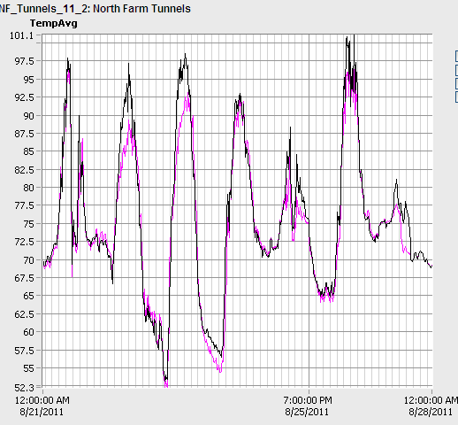
Notes:
And this was during a heat wave… July 2011 had 16 consecutive days over 90F. This chart is in August. The black line is the air temperature inside the tunnel and the pink line is the temperature outside the tunnel. It wasn’t much hotter under the tunnels than outside the tunnels, because the sides of the tunnels were up.

Slide 5
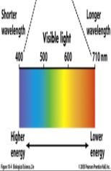
UV
UV
Near-Infrared
Infrared
Provided by ARS Beltsville scientists Dr. Craig Daughtry and technician Mr. Andrew Russ.
Notes:
But the day after I raised the tunnels, I saw an immediate and dramatic improvement in the fruit quality. I realized instantly that the tunnels themselves were somehow reducing stress for the plant. I suspected maybe the plastic was filtering the light and maybe that had something to do with it. It turns out there is support for that idea. The plastic I bought is screening out about 15% of the visible light waves in addition to more of the damaging longer light waves. A couple of strawberry studies have shown that they don’t always prefer full sunlight. It’s possible that, like tomatoes, reducing some light, can increase a strawberry plant’s tolerance to higher temperatures. In addition, the plastic was screening out more infrared light, which can be stressful to plants.
Dr. Craig Daughtry, USDA-ARS Beltsville, MD. Licor spectroradiometer.

Slide 6
Notes:
So, already the low tunnels have allowed season extension from our usual three to four weeks. Now we have production from mid-June to early September, though we’ve learned the boundaries vary each year and with management.
All the cultivars we tried had some advantage, and no single cultivar had everything. So I recommend you try several to see what works for you and your market. In the year of planting, ‘Portola’ and ‘Monterey’ had the best yields with ‘Seascape’ doing OK too. And with it’s great flavor, ‘Albion’ is worth trying too. But note how ‘San Andreas’ and ‘Diamante’ wait until August and September to really get in the act.

Slide 7
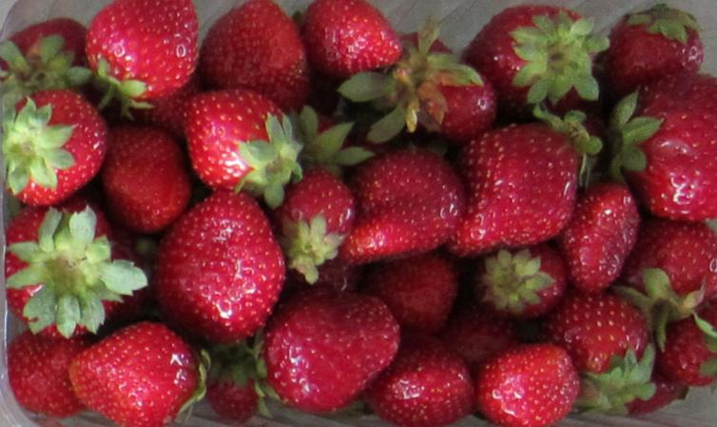
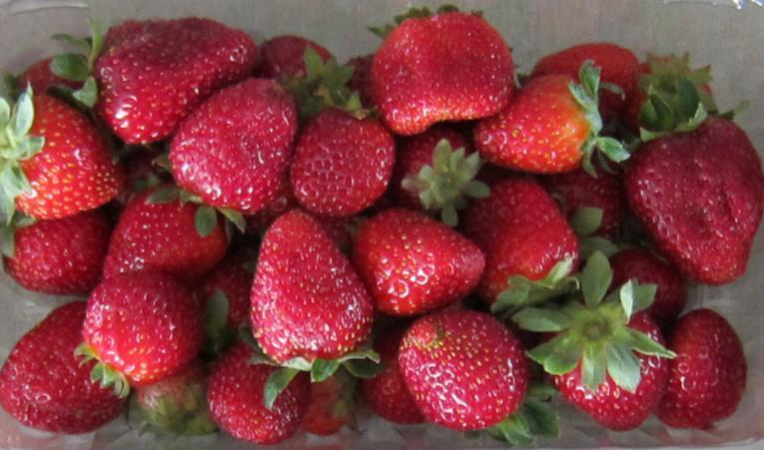
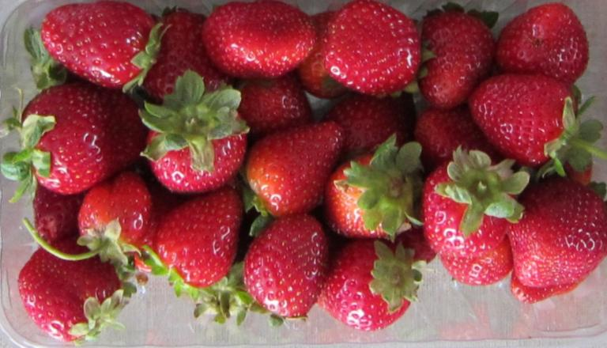
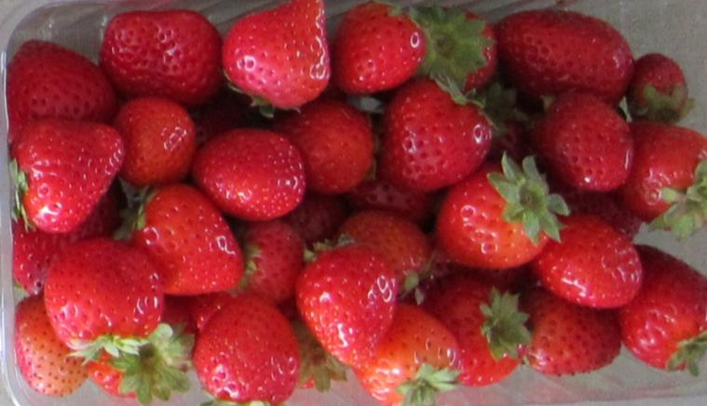
‘Seascape’
‘Albion’
‘Monterey’
‘Portola’
Notes:
The next surprise was that the fruit quality in July was the best I had ever seen. With no fungicides, there was no sign of disease, and the fruit lasted a long time in the refrigerator… two weeks in the refrigerator with excellent results. At that point I realized this was not just a breeding tool anymore… this had potential as a real production system.

Slide 8
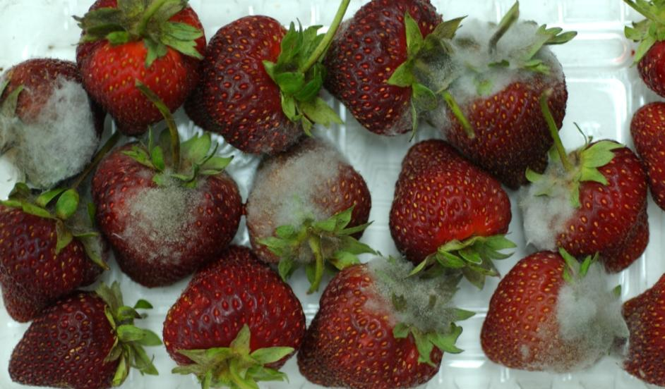
Fruit from tunnels.
And NO FUNGICIDES!
This is Botrytis fruit rot. We did NOT see Botrytis in the tunnel fruit, even after storage.
Notes:
Meanwhile, there’s more to tell about the fruit quality…. One of the most striking observations was that I didn’t see botrytis fruit rot. There were only four infected berries all of 2011 and six in 2012 in the tunnels. And fruit harvested from the tunnels lasted in the refrigerator with exceptionally good quality and no botrytis. And I didn’t use any fungicides.

Slide 9
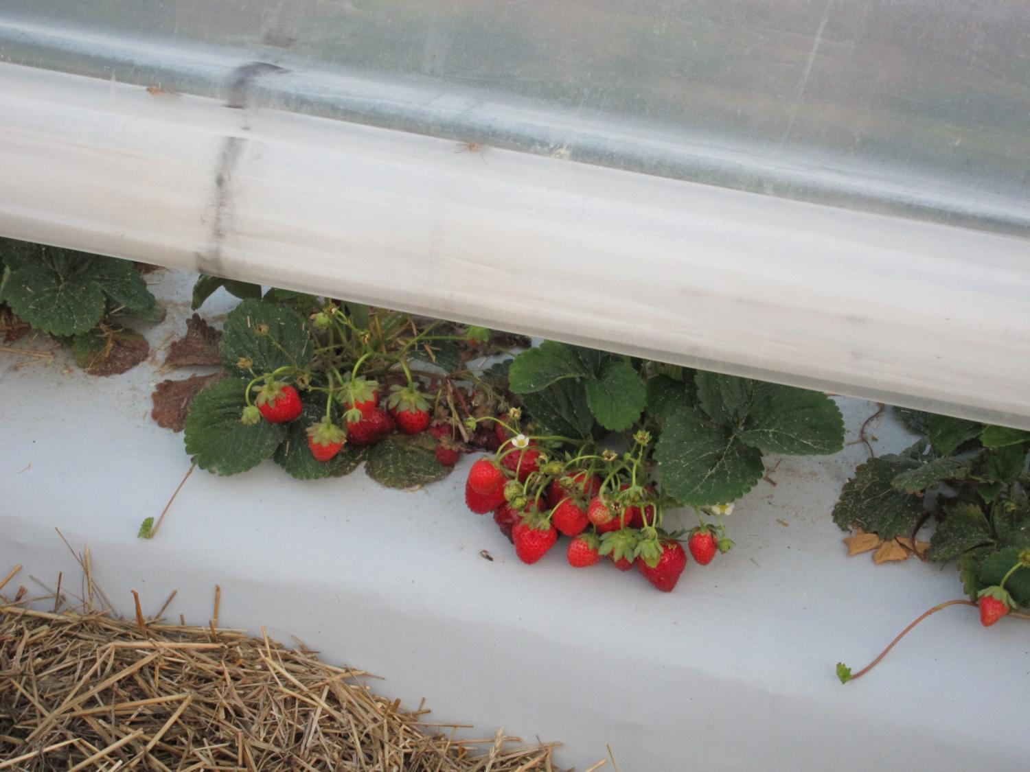
Notes:
I had read that this might be expected because the tunnels act as rain shields to keep the plants dry.

Slide 10
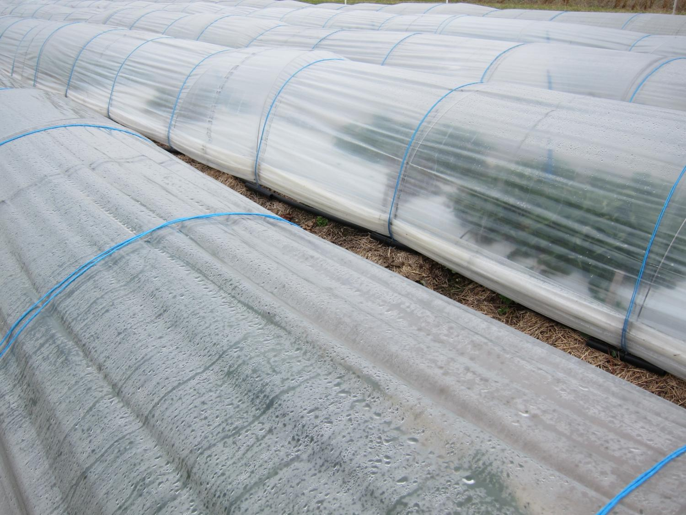
Notes:
But they do get wet in the fall with the frost protection. And temperatures were cool so that Botrytis should have been a problem. But it wasn’t. Why????

Slide 11
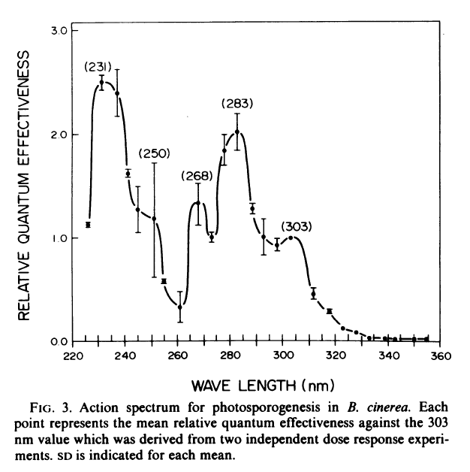
Notes:
It turns out that Botrytis is one of those fungi that needs UV light to make spores so it can spread. And….

Slide 12
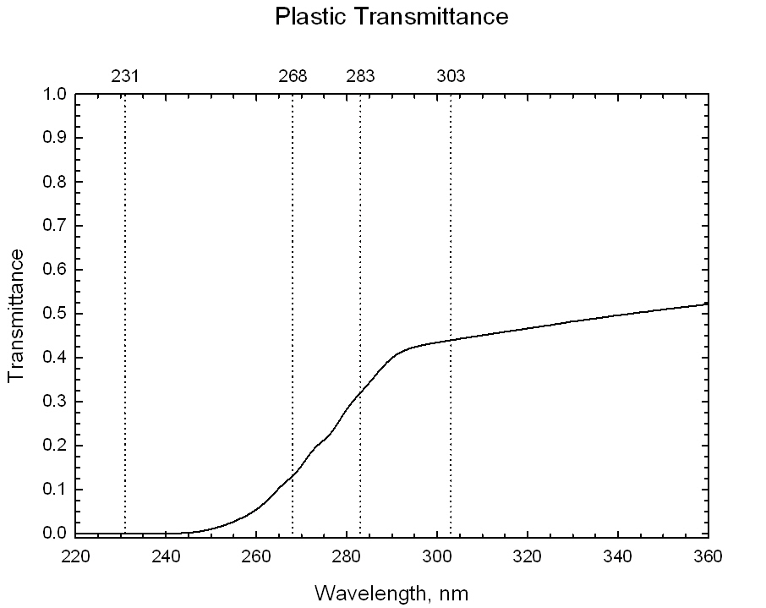
Provided by ARS Beltsville scientists Dr. Craig Daughtry and technician Mr. Andrew Russ.
Notes:
… it turns out the plastic I used for the tunnels blocks out most of the light wavelengths required for the Botrytis to form sores… so it doesn’t spread. Or at least that’s a good theory. I am hoping that someone does some research on this.
Dr. Craig Daughtry, USDA-ARS, Beltsville, Md. Spectrophotometer.

Slide 13
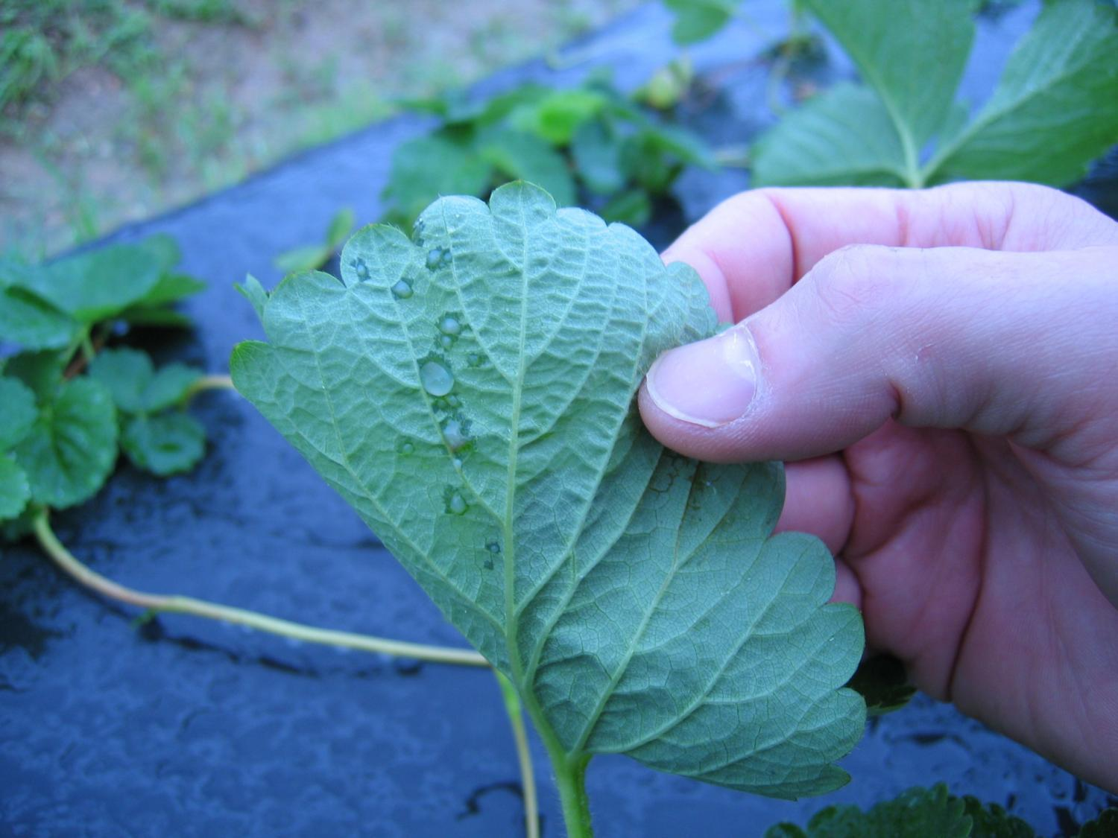
Notes:
Another disease I thought we might see in the cooler temperatures was bacterial angular leafspot disease, but we didn’t. Except for the anthracnose, these low tunnels are pretty disease free.

Slide 14
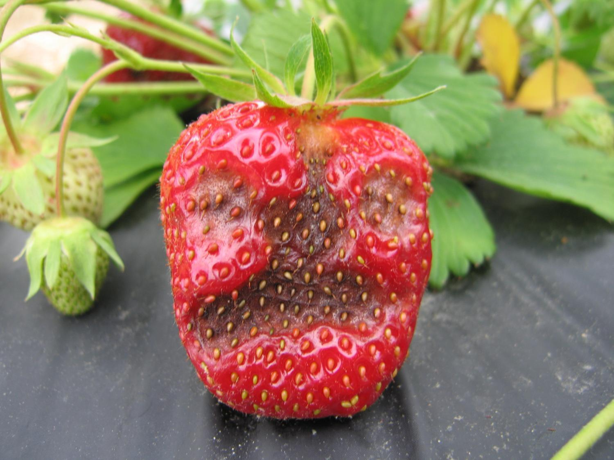
Notes:
And in a heavy rainstorm with high winds and sideways rain, we can get anthracnose for a week on the more susceptible cultivars. But adding a thick coating of straw down the aisle the practically eliminated anthracnose under the tunnels, though it is still the problem in the open beds with the susceptible varieties from other breeding programs. Because the dayneutral part of the breeding program is new to us, we haven’t had time to breed in the resistance that all our once-fruiting varieties have, though older dayneutrals ‘Tribute’ and ‘Tristar’ are resistant.

Slide 15
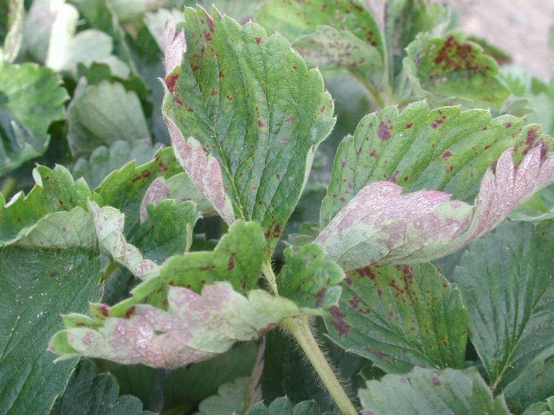
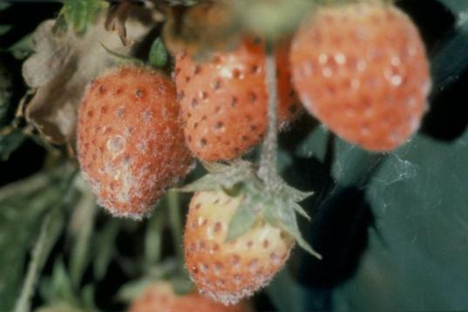
NO powdery mildew
Notes:
I expected to see a lot of powdery mildew in these tunnels because it’s a problem with high tunnels, but in my low tunnels, there was none.

Slide 16
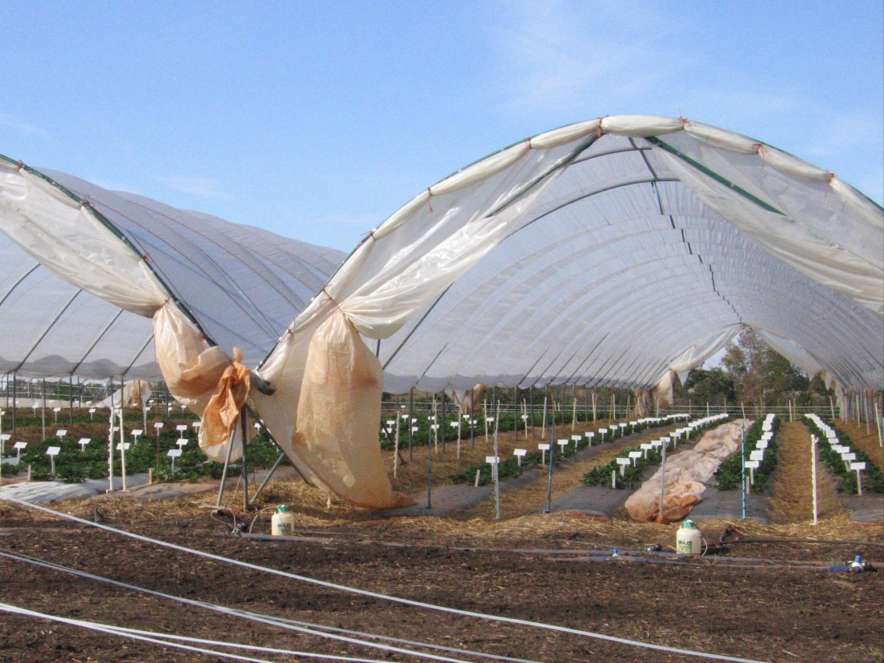
Notes:
Powdery mildew grows really well in high humidity conditions, and high tunnels are often quite humid.

Slide 17
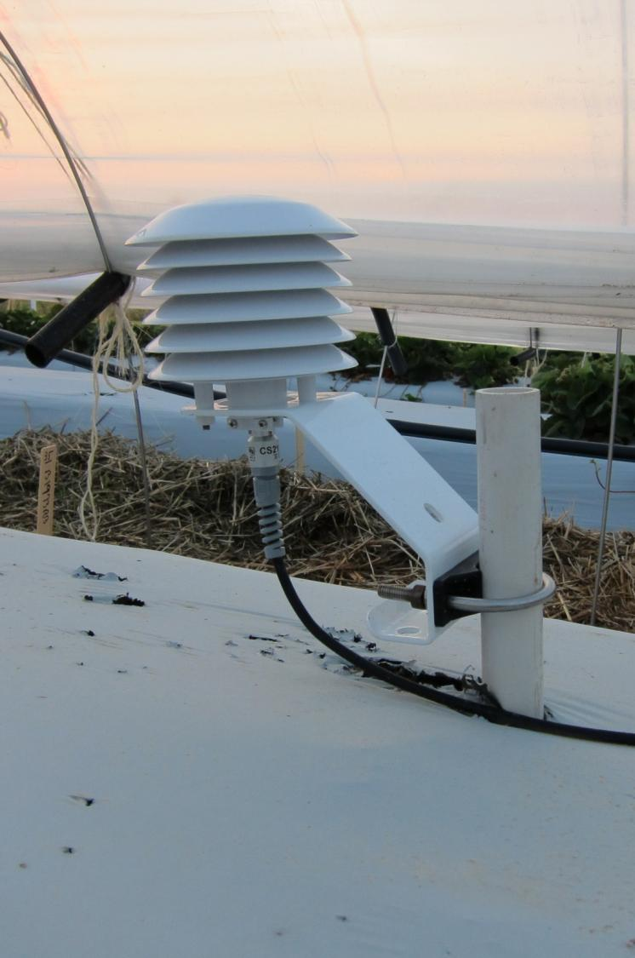
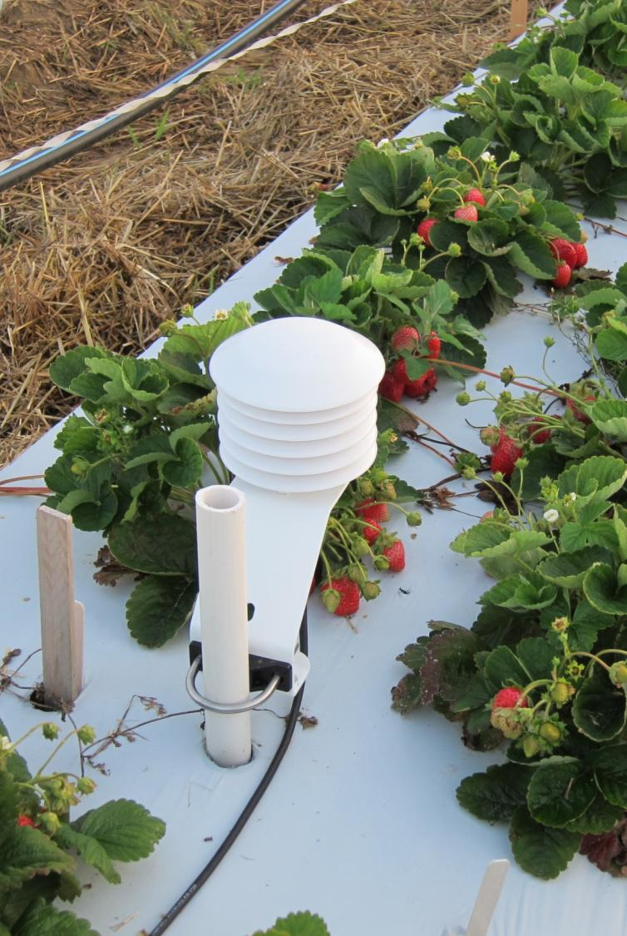
Notes:
But we measured humidity inside and outside the tunnels and they were the same through the summer. After I dropped the sides in early October, the humidity inside the tunnels was actually lower until the first week of November… So maybe that’s why there was no powdery mildew. The low tunnels create a very different micro-environment from high tunnels, because the low tunnels are so much smaller than the high tunnels.

Slide 18
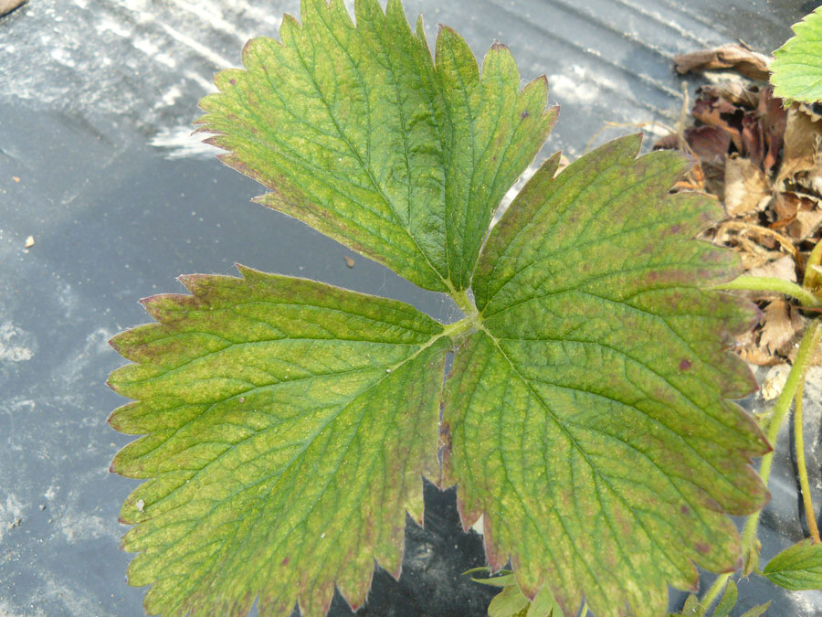
Notes:
Mites also are a problem in high tunnels. In the low tunnels, when we have seen mites it was for one of two reasons. One was because I was trying to determine how soon to raise the sides of the tunnels in spring the second year. I waited too long and it got really hot under there. As soon as we noticed the mites we raised the sides to cool them; then we ran the misters to get them wet. That took care of the problem. The second time we saw mite damage was because infested greenhouse-grown plants were planted. They left the plants but the damage remained for awhile.

Slide 19
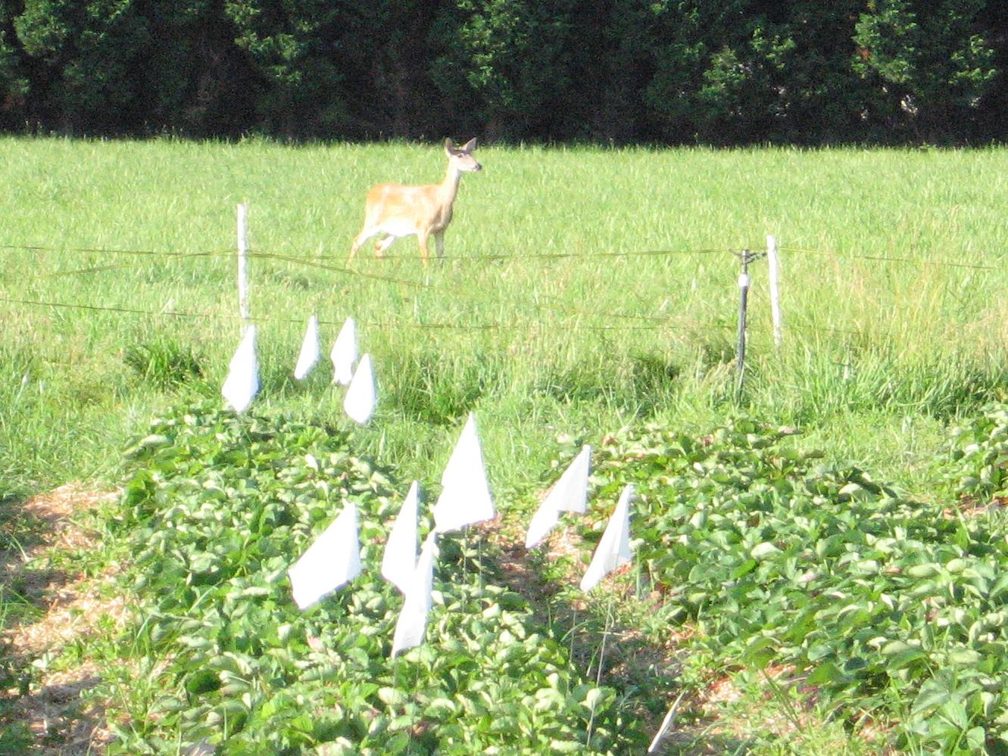
Notes:
The deer do not like to come into a field of solid low tunnels! They will nibble on plants on the outside beds/tunnels, but they don’t enter the field. And with the death in Oregon in 2011 from the deer with that nasty E. coli, wandering into a strawberry field, this is an even bigger issue.

Slide 20
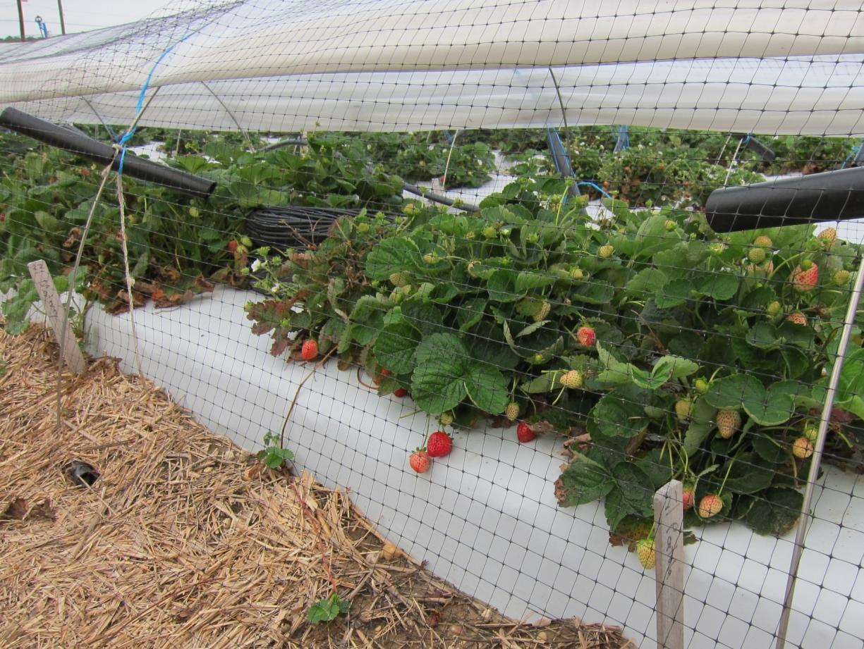
Notes:
Birds will fly under the tunnels for a few months after they are first erected. After they experience a few instances of being frightened and bouncing around inside the tunnels, they tend to keep out. One year we used netting to protect our expensive probes from foxes. The netting also kept out the birds.

Slide 21
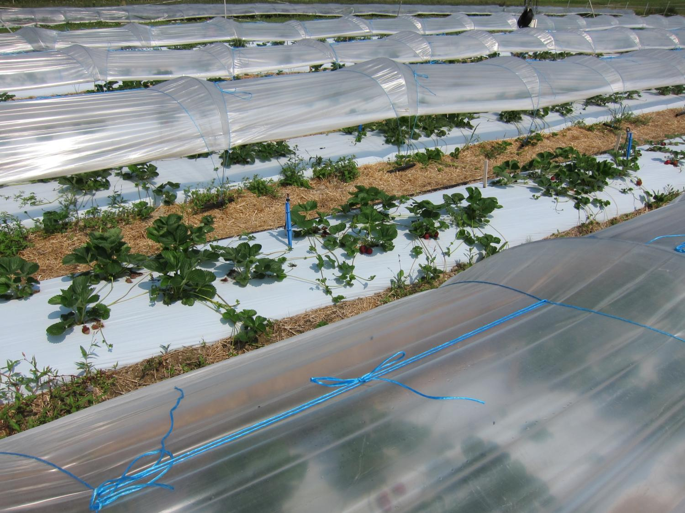
Notes:
In 2011, I also had a border bed with white plastic but without a tunnel, and for a short time, it produced some good fruit too. So in 2012 I set up the field to compare low tunnels and open beds with white plastic. I also need to make this comparison to predict what performance I might get from dayneutral seedlings growing in the tunnels next year while I am evaluating them in open beds the current year.

Slide 22
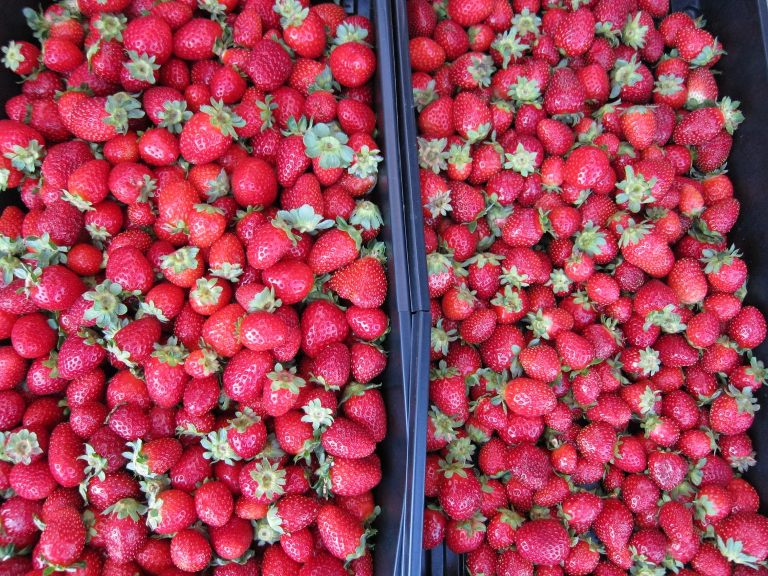
Notes:
First of all, the fruit size was better from the low-tunnel plants.

Slide 23
Tunnels fruit sooner, the season is more spread out,
and less fruit is lost to disease and stress. Do not de-blossom.
Notes:
This slide compares what happened inside and outside the tunnels. Inside is in blue. Outside is in green. The solid lines are total fruit and the dashed lines are non-rotted fruit. Comparing the two dashed lines shows the tunnels reduce rot. Also notice the shape of the curves. See how the yield outside the tunnels has a narrower season and the tunnel fruit has a more spread-out season? Part of the difference between the two solid lines from August on is that the fruit in the open beds was smaller and not shaped as well. Also, notice the little bump here at the beginning? This is fruit from buds formed in the nursery, while the rest is from buds formed in my production field.

Slide 24
Notes:
Anthracnose was the main disease in the open beds without low tunnels.

Slide 25
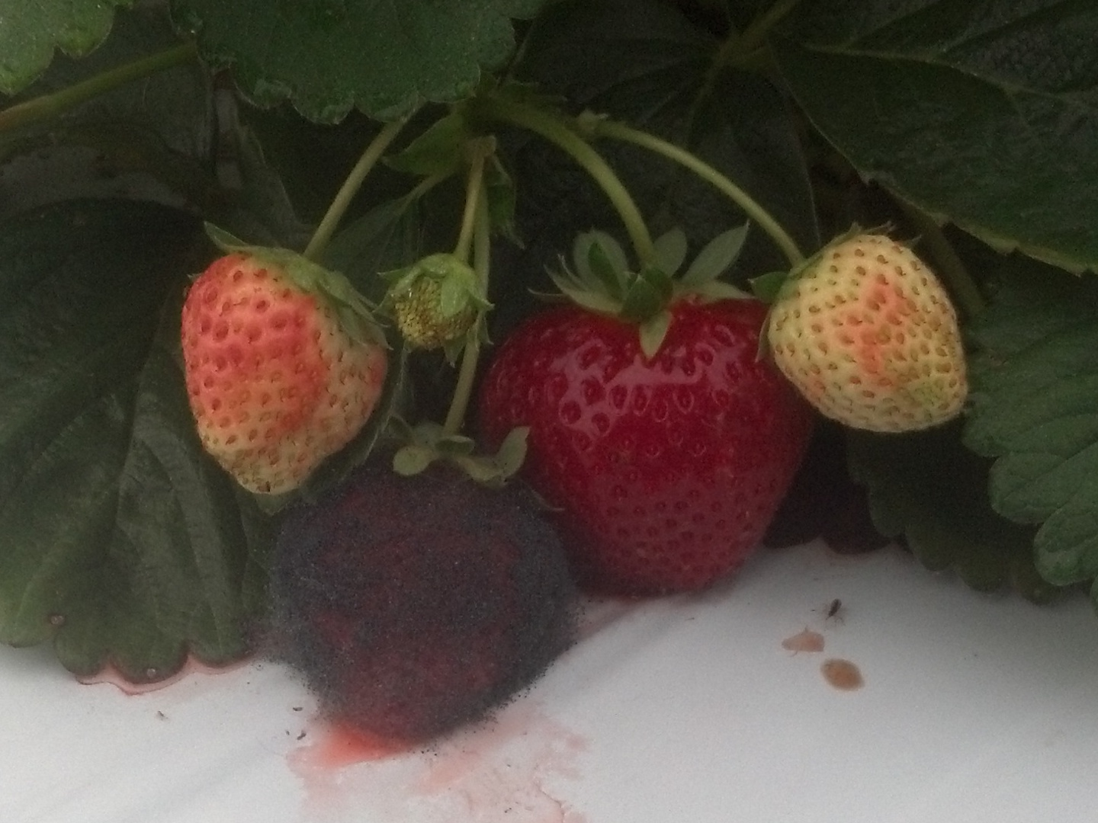
Notes:
Mucor is the problem disease in the low-tunnel AND open beds, but we don’t see it in our spring fruit, because it requires weather that is more humid and warmer through the days and nights than we see in spring. It is an opportunistic fungus that requires some way to penetrate the skin of the fruit.

Slide 26
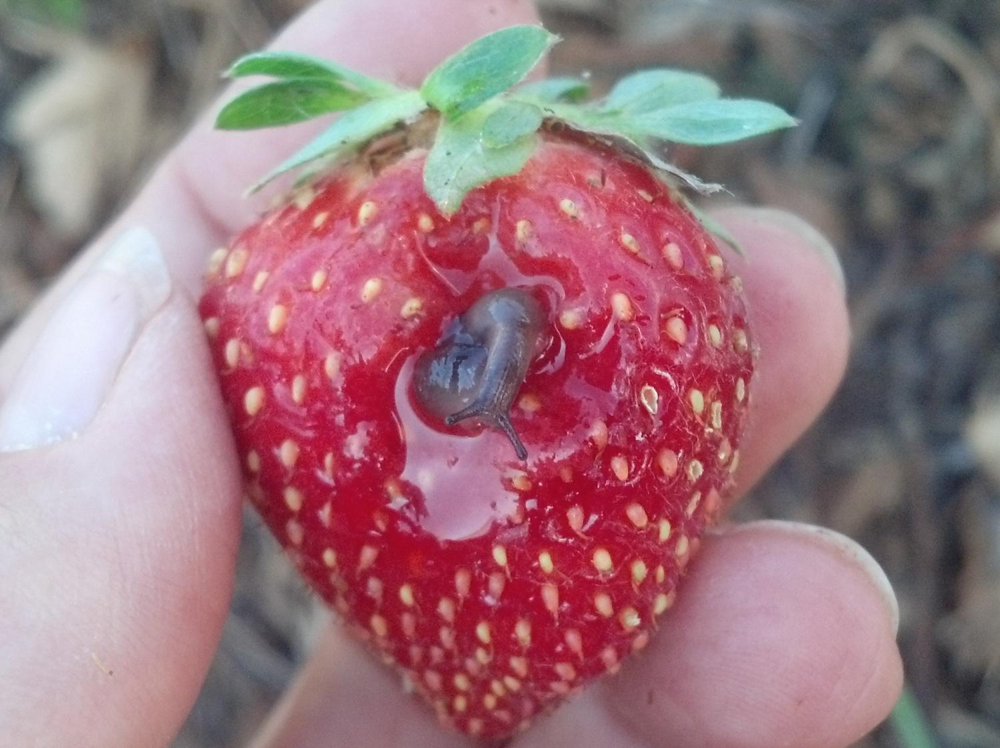
Slugs
Ants
Too much N
Irrigation timing
Notes:
…like slugs or ants this year. We reduced the problem this year by using less nitrogen fertilizer to make the skin tougher, and by watering only on Mondays and Thursdays when the ripest fruit with the most tender skins have been removed.

Slide 27
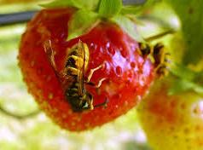
Notes:
In the fall, in the open beds we were sometimes stung by wasps still sleeping in the protective foliage of the plants. We did not get stung when picking fruits under the low tunnels for some reason.

Slide 28
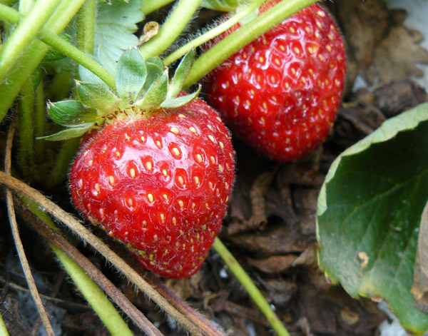
Notes:
I also want to point out that, in spite of the strawberries fruiting all summer and fall long, I have not seen any spotted-winged Drosophila damage. That could be really important if it holds up under expert scrutiny, so I am planning a bit of sleuthing with a new entomologist at the University of Maryland.

Slide 29
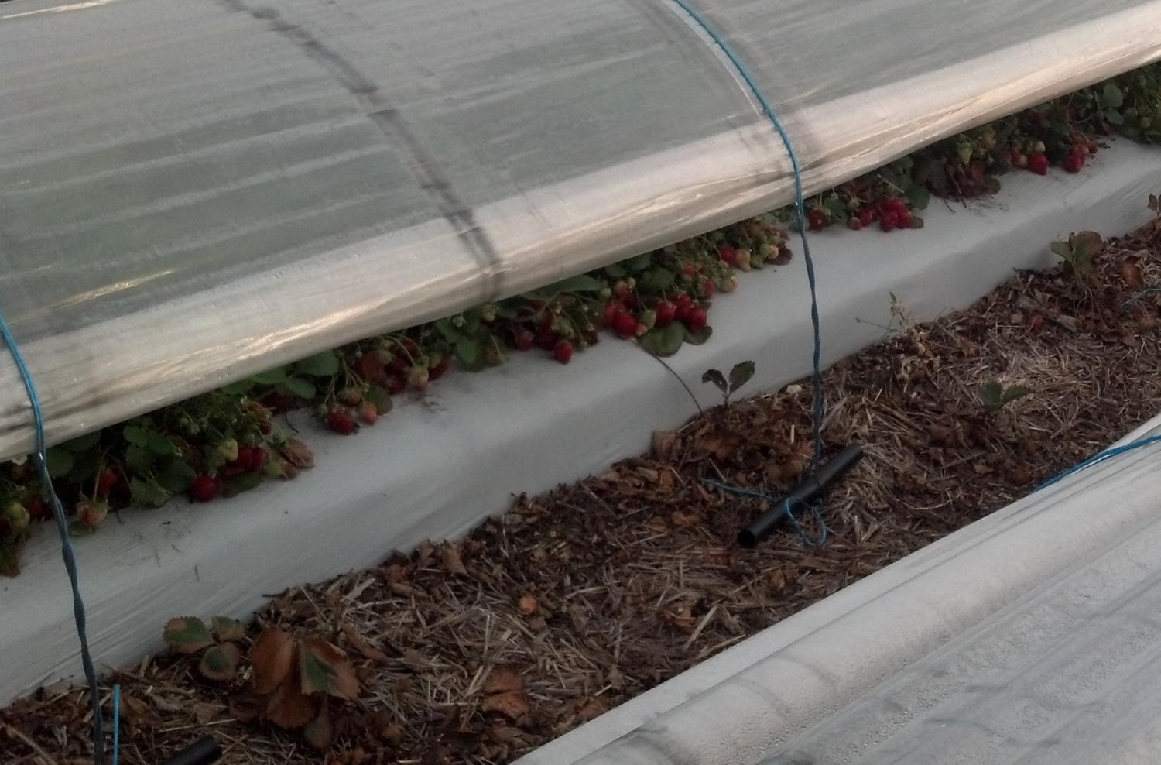
April Strawberries on 2nd-year plants
Notes:
Plants from these low tunnels fruit the year they are planted and then produce fruit again the following spring… as early as mid-April in 2012 (a very mild winter and early spring). This is ‘Seascape’.

Slide 30
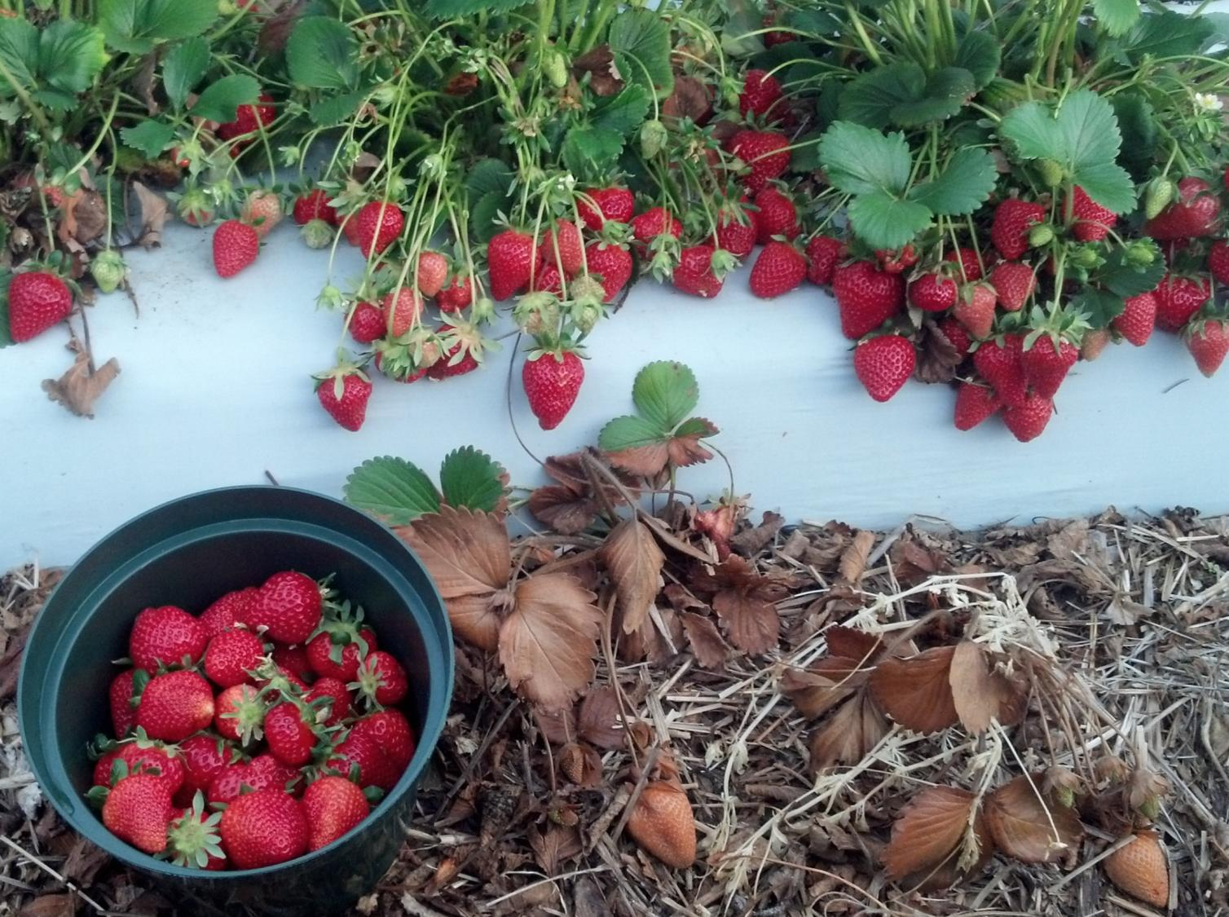
Notes:
This is ‘San Andreas’ in April. The yield in the bucket is from just three plants.

Slide 31
Notes:
Spring of 2012, ‘San Andreas’ and ‘Evie 2’ were the show-offs. ‘Seascape’ did ok too and ‘Albion’, with it’s great flavor is still worth growing. But ‘Portola’ and ‘Monterey’ are pretty much done, and that’s because of disease killing the plants…. Anthracnose it looks like, but I don’t know.

Slide 32
Notes:
By fruiting a single set of low-tunnels for two years, we have been able to produce very high quality fruit from mid-April until Christmas in mild years, and with varieties that aren’t even adapted to our location. The extended season reduces risk to growers and provides a steady supply of fruit to consumers. And with breeding we’ve already seen that we can significantly improve yield.

Slide 33
No perfect cultivar
 | 2011-2012 tunnel yields (lbs/A) |  |  |  | 2012-2013 tunnel yields (lbs/A.)
Genotype | 2011 | 2012 | Total |  | 2012 | 2013 | Total
Evie2 | 9,515 | 25,204 | 34,720 |  | . | . | .
Seascape | 13,748 | 20,501 | 34,249 |  | 15,816 | 16,389 | 32,205
Portola | 19,669 | 11,645 | 31,315 |  | 25,444 | 11,642 | 37,086
San Andreas | 8,885 | 21,032 | 29,917 |  | 12,303 | 11,801 | 24,104
Monterey | 14,788 | 12,000 | 26,789 |  | 18,044 | 8,470 | 26,514
Albion | 9,841 | 12,825 | 22,666 |  | 12,451 | 6,623 | 19,074
Diamante | . | . | . |  | 10,758 | 6,900 | 17,658
Notes:
There is no perfect cultivar. But they all have something to offer. This table is a little complicated. All the yields are from under tunnels. The set on the left are from the tunnels planted in 2011… a first and second year of yields. The set on the right are from the tunnels planted in 2012 … a first and second year of yields. Note the planting year yields are higher in 2012 because I erected the tunnels sooner, but the 2nd year yields are lower because I made the mistake of letting them heat up too much before raising the sides for the spring. Also note that some cultivars do better the year of planting, others do best the next year (unless you cook them), and some hold their own both years. In both these years there were yield losses due to me not knowing yet how to best manage low-tunnels, so the yields do not really reflect potential, but they can be used for comparison of cultivars.

Slide 34
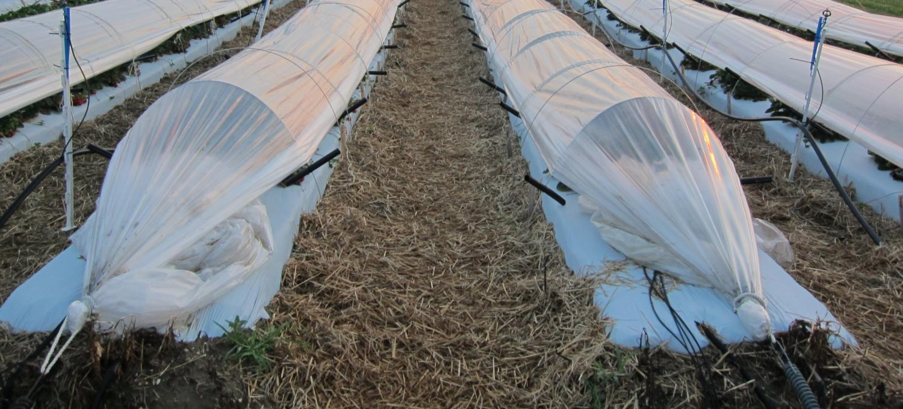
 | Amount | Cost | Reusable?
Tunnels
Clear poly 4 mil plastic 12' x 240' | one 240 ft roll | $130 | no
1/4" Stainless steel rods | 40 12 ft pieces ¼ $6.55 ea (incl ship) | $262 | yes
5' T-posts for ends | two | $14 | yes
"Stoppers" (HD 100 SIDR 15 PE 3408 CS-100 PSI PR water at 73°F (6 in long) | 40' | $12 | yes
Tyrite 9600-170 polypropylene baler twine | Around 900 ft | $4 | no
Total for one 200-ft tunnel Total per acre (44 rows, 5-ft centers) |  | $462 $20,328 | ($2.31/ft)
Notes:
So I thought I had better take a look at the costs.

Slide 35
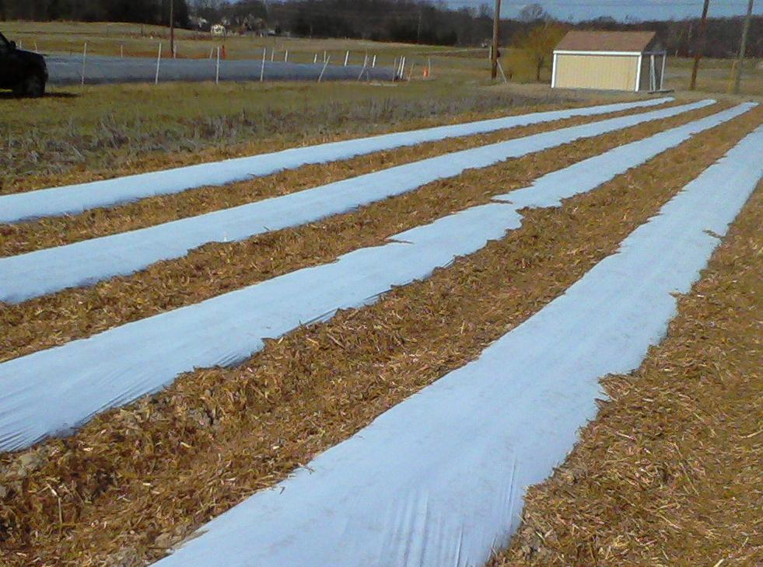
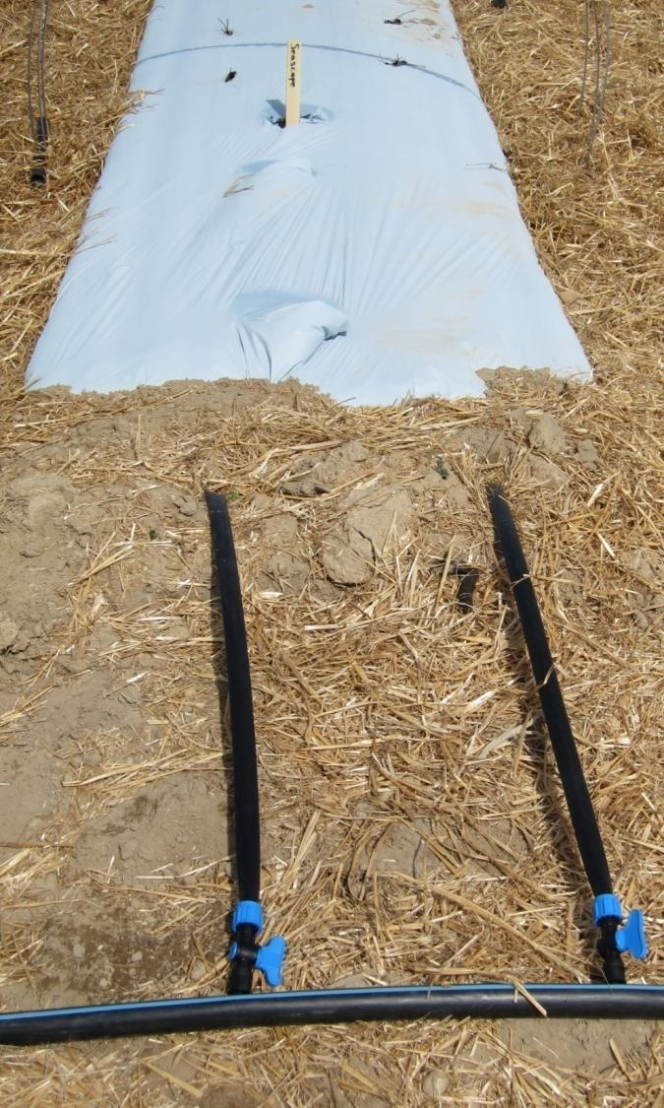
Beds:
February
Two rows of trickle line, 12” apart
Black mulch topped with white-on-black mulch
Straw between beds for anthracnose, weeds, and erosion control
Notes:
So now let me tell you how I made them. We made the beds using White-on-black mulch over black mulch, thinking we would remove the top layer in the fall… but that didn’t happen because we think we may be able to get two or more years of yield from one planting. I hope someone does some research to see if dayneutrals could be grown in raised matted-row beds covered with tunnels. I think this would prolong the field lifetime even longer than with using plasticulture. One of these years I will use a white-on black mulch without the second mulch layer below. Two rows of trickle are important because the plants are entirely dependant on irrigation (no rain under the tunnels).

Slide 36
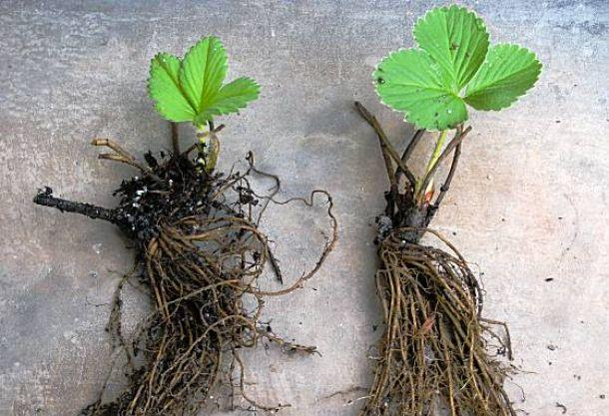
Planting
Early March
Bare-root dormant day-neutral varieties
12” to 15” in the row
14” between rows
Notes:
One of the best things about this system is that planting in early spring allows the use of bare-root dormant plants and so a wide cultivar choice. We’ve used two row spacings and either one will work.

Slide 37
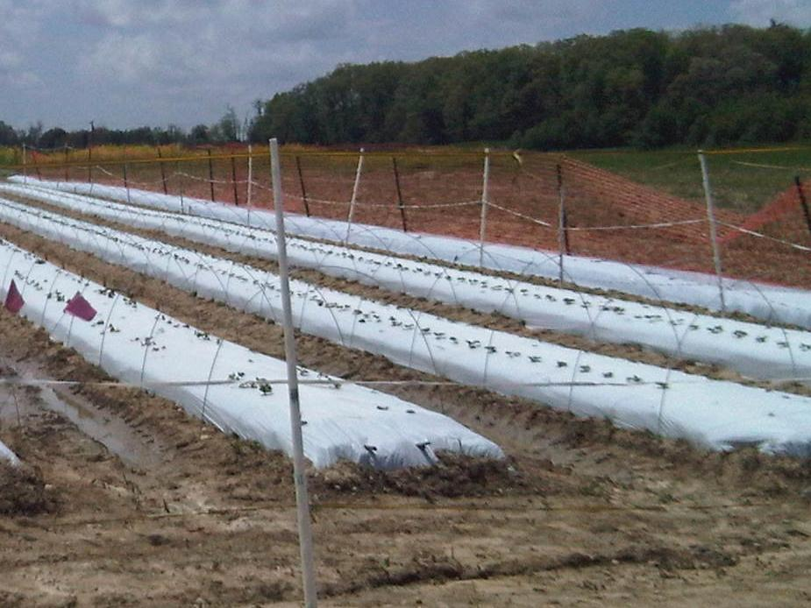
Hoops:
March
Every 4-5 feet
12 ft-long, 1/4 in stainless steel rods
Each hoop end 2 ft deep
Notes:
For the rest of the construction (after planting) I have developed a step-by step procedure that allows one little-bity person like me to do this all by myself. Of course it’s more fun to have lots of people.
To make the supporting hoops for the tunnels I used straight (no need to pre-bend) 12-foot long pieces of 1/4 inch stainless steel rods every four to five feet. The first year I used 3/16 inch steel, but when I tried¼ inch steel in 2014, the tunnels were much more stable through all kinds of weather. I’ll never again use 3/16 inch steel!

Slide 38
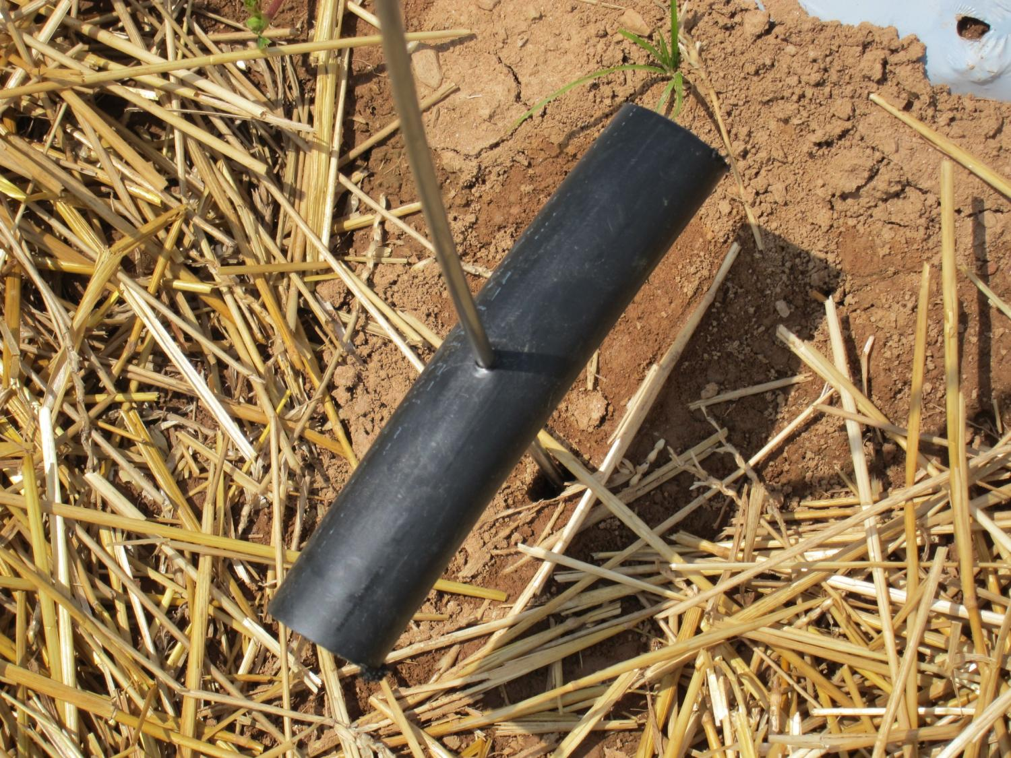
Notes:
Before placing the steel in the ground, I placed these “stoppers on each end, two feet from the ends. The “stoppers” were made by drilling 7/32” holes perpendicularly through the center of a 6” long piece of 1 inch diameter black polyethylene plastic water pipe. This is a grower-inspired modification of an earlier design.

Slide 39
Hoops:
March
Every 4-5 feet
12 ft-long, 1/4 in stainless steel rods
Each hoop end 2 ft deep
Notes:
I used a hammer drill to make pilot holes, and the bit, made by our Research Support Services, was a 3-ft piece of rebar with a tip that was hardened then ground to a point. I angle the pilot hole inward at about 45 degrees to make more of a circle than a hoop. That helps the plastic stay down in the winter, especially on the ends of each tunnel. I poked one end of each piece of steel into the ground about 6 inches away from the side of the bed (I use a spot on my boot as a guide). I did this down one side of the bed and then went around to the other side all the way down the bed. I put them in 2 feet deep, using the stoppers to help guide me.

Slide 40
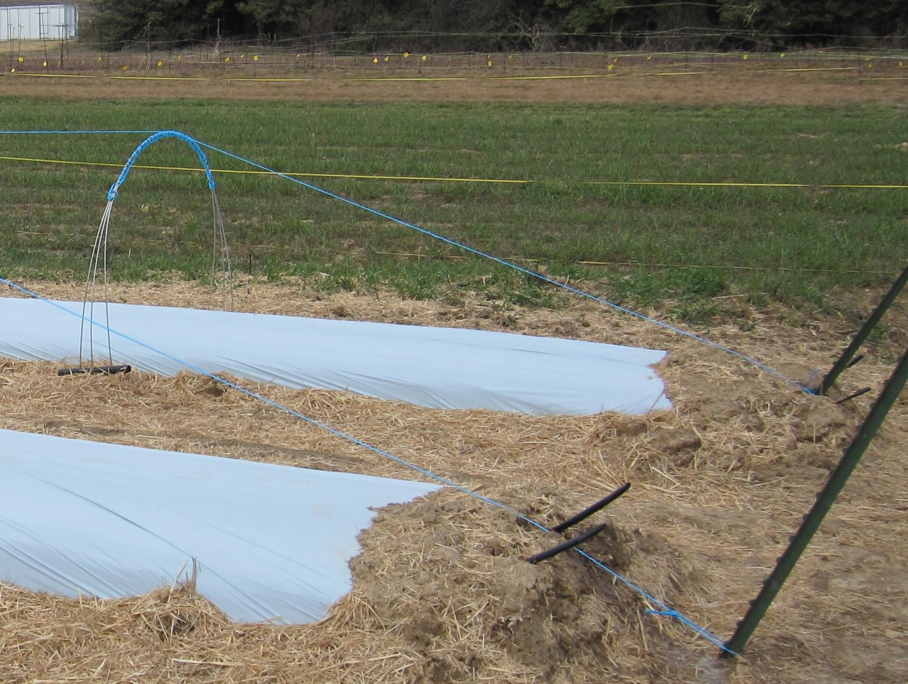
Set a T-bar at each end, and
loop bailing twine across the top at each hoop.
Notes:
I used t-posts at each end of the bed (200 ft long bed) to tie the plastic sheeting to that makes the tunnel. I used to think it was important to set the t-bars at an angle like this, but it isn’t and they don’t have to be so far from the last hoop. They don’t have to be this tall either. The pictures I have from Israel show the plastic can just be buried at the end.
Then I tie the end of a roll of bailing twine to one t-post towards the base as shown here. And I loop the roll of twine around the closest hoop, then the next, and the next… all the way down to the other t-post, where I attach the twine with a taught-line hitch that tightens as I pull it and won’t loose. This was another grower idea.
http://www.netknots.com/rope_knots/tautline-hitch/

Slide 41
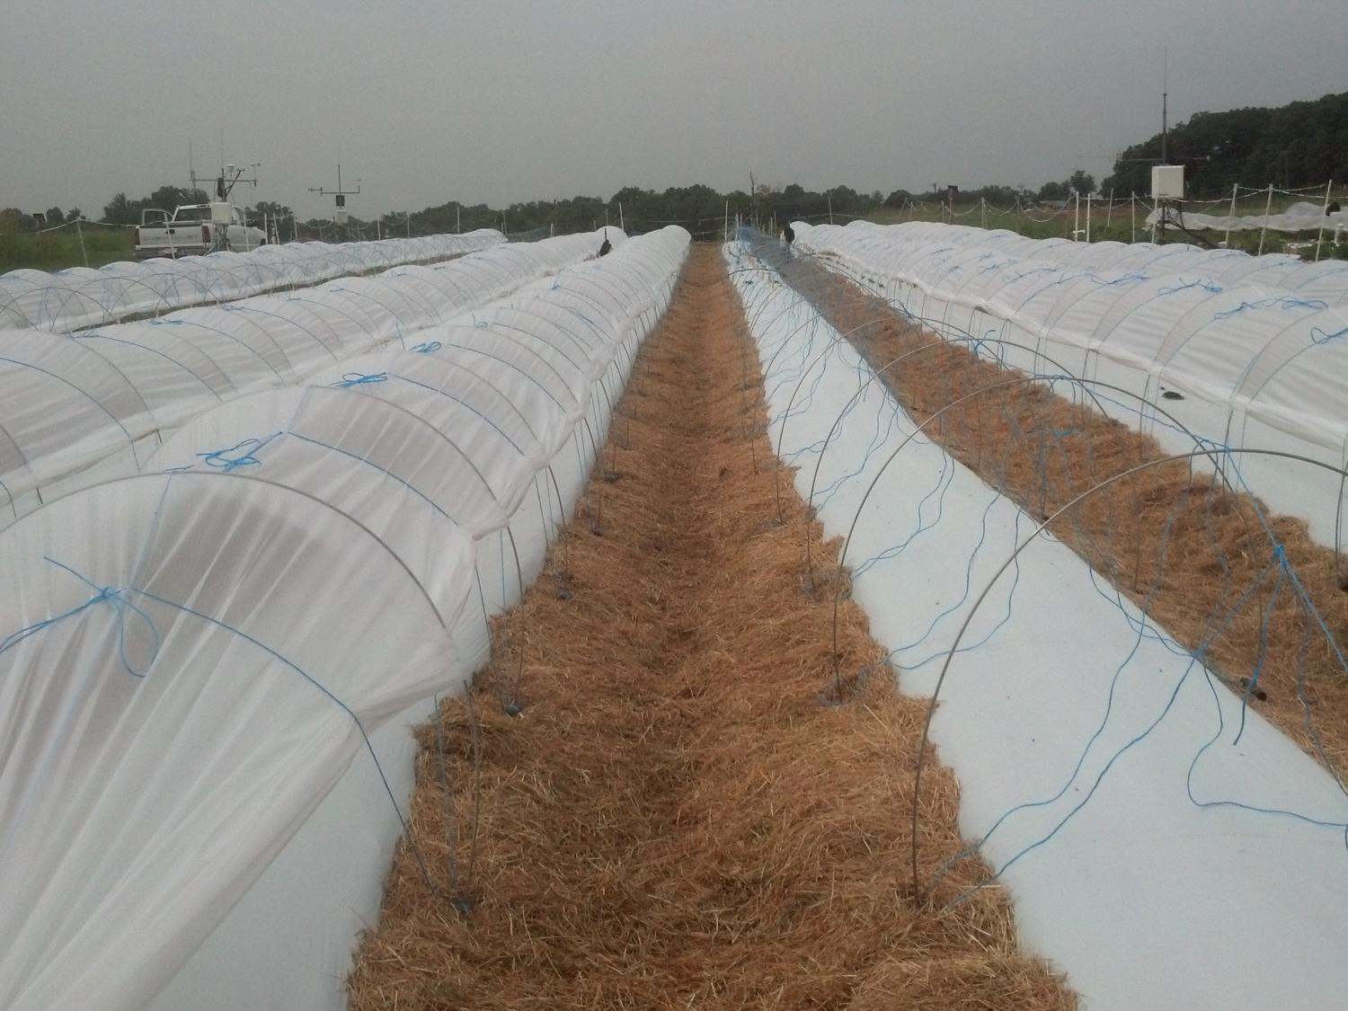
4 or 6 mil thick x 12 ft wide clear plastic sheeting
No holes
Notes:
I have used 4 ml sheeting for the tunnels, and found they are in good shape still when I am finished with them a year and a half later. A grower used 6 ml and it was not any harder to manipulate.

Slide 42
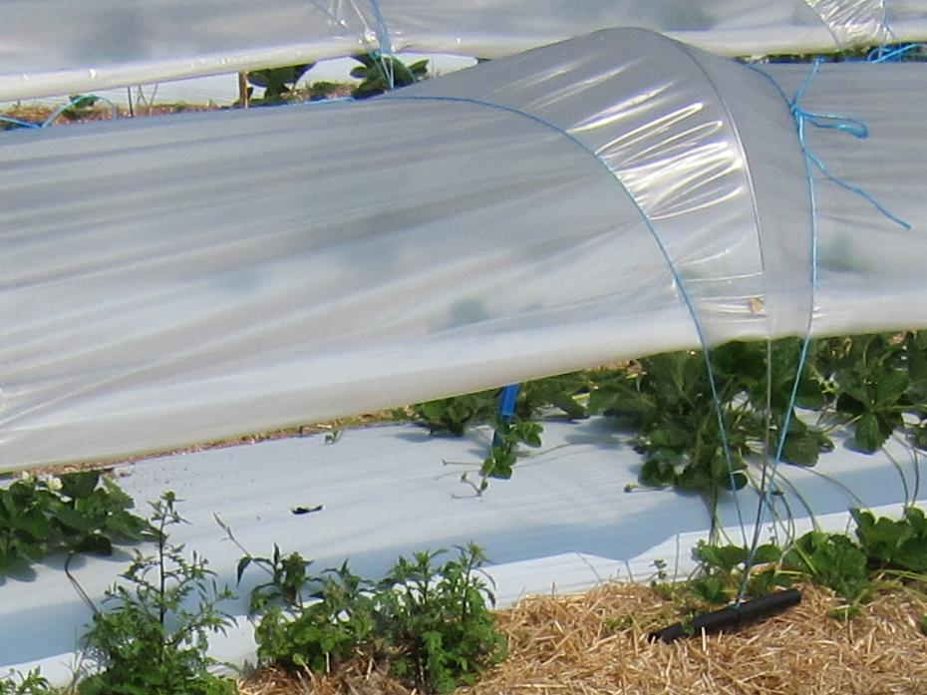
Twine and “stoppers”
Notes:
The sheeting is attached to the hoops at each hoop. This is where the tension is important; not from end to end at the t-posts. The plastic sheeting is first pulled along the ground and secured at each end then up over the hoops and secured to each hoop with a 20-ft piece of bailing twine and these stoppers. I used sisal twine at first but switched to plastic bailing twine because the sisal rotted. I also tried 5/16” polyester bungee cord but it pulled the stoppers up, so I won’t try it again unless I can keep the stoppers from riding up the hoops. Even then, I’m not sure the bungees are worth the extra $85 per 200 ft tunnel. I like the way I can secure the plastic to the hoops with the bailing twine before lifting the plastic up so that as the wind picks up in the day the plastic is still secured to the hoops right away.

Slide 43
Notes:
Here’s how: I cut the 20-foot long pieces of bailing twine. After I cut 20 of those, I braid them together using a daisy chain so they can be easily stored and just as easily unraveled for use. When I am ready to use them, I unravel them and loop them over my shoulders as I attach each to a hoop. First I use the taught-line hitch again to make a large loop from a 20-ft long piece of twine. I stand facing the bed and hoop and my shoulders parallel to the bed. Then I toss the loop of twine over the hoop with one side of the twine on each side (left and right). I adjust the loop of twine so that when I tighten the loop at a later step it will end up at the top of the tunnel (this takes practice). I hook the loop loosely under the stopper facing me. I repeat at each hoop. When I reach the other end of the tunnel, I loop the twine under the other stopper so any wind doesn’t blow the loops out of place. Right before I bring out the sheeting, this is what the tunnel looks like.

Slide 44
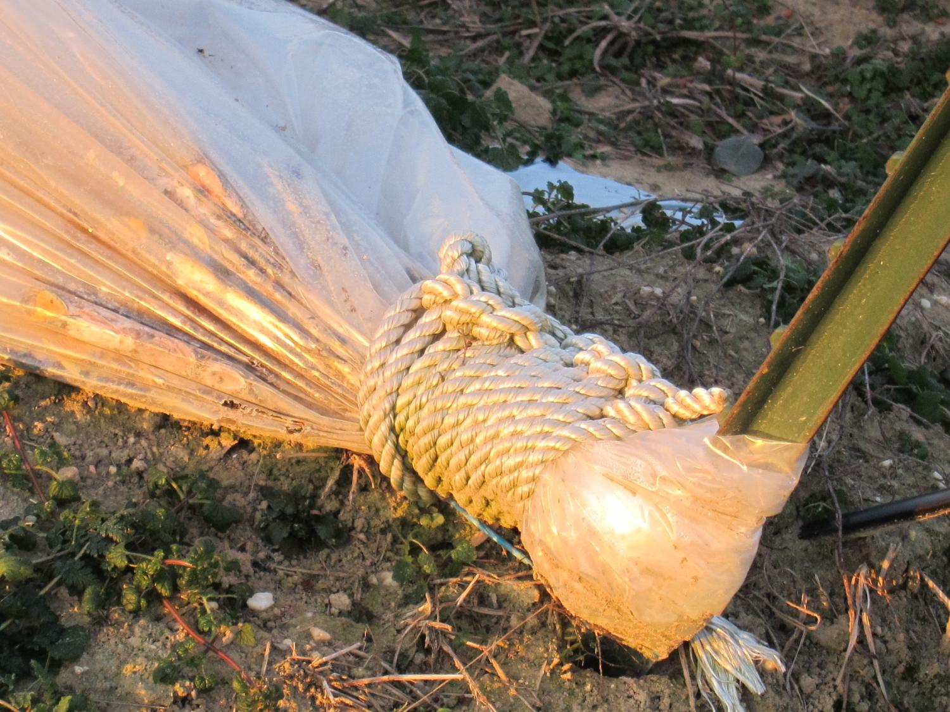
Notes:
I park my pick-up at the end of a bed and roll the plastic out like a roll of toilet paper, pulling it with me to the other end so that it is laying on the side of the bed furthest away from the direction of the wind (if the wind is from the west, the sheeting should be laid on the ground on the east side of the bed). The un-rolled plastic comes folded lengthwise, so at each end, where you intend to attach it to the t-post, un-fold it and then pleat it with your two hands, and using your thigh as a “table”. Then wrap the pleated sheeting around the base of the t-post, fold it back on itself, and secure it in place with a series of half-hitch knots of about 10 ft of poly cording. Do NOT pull the plastic tight as it wraps around the t-post, as that causes the end hoop to collapse. Instead, apply tension on each hoop in future steps.

Slide 45
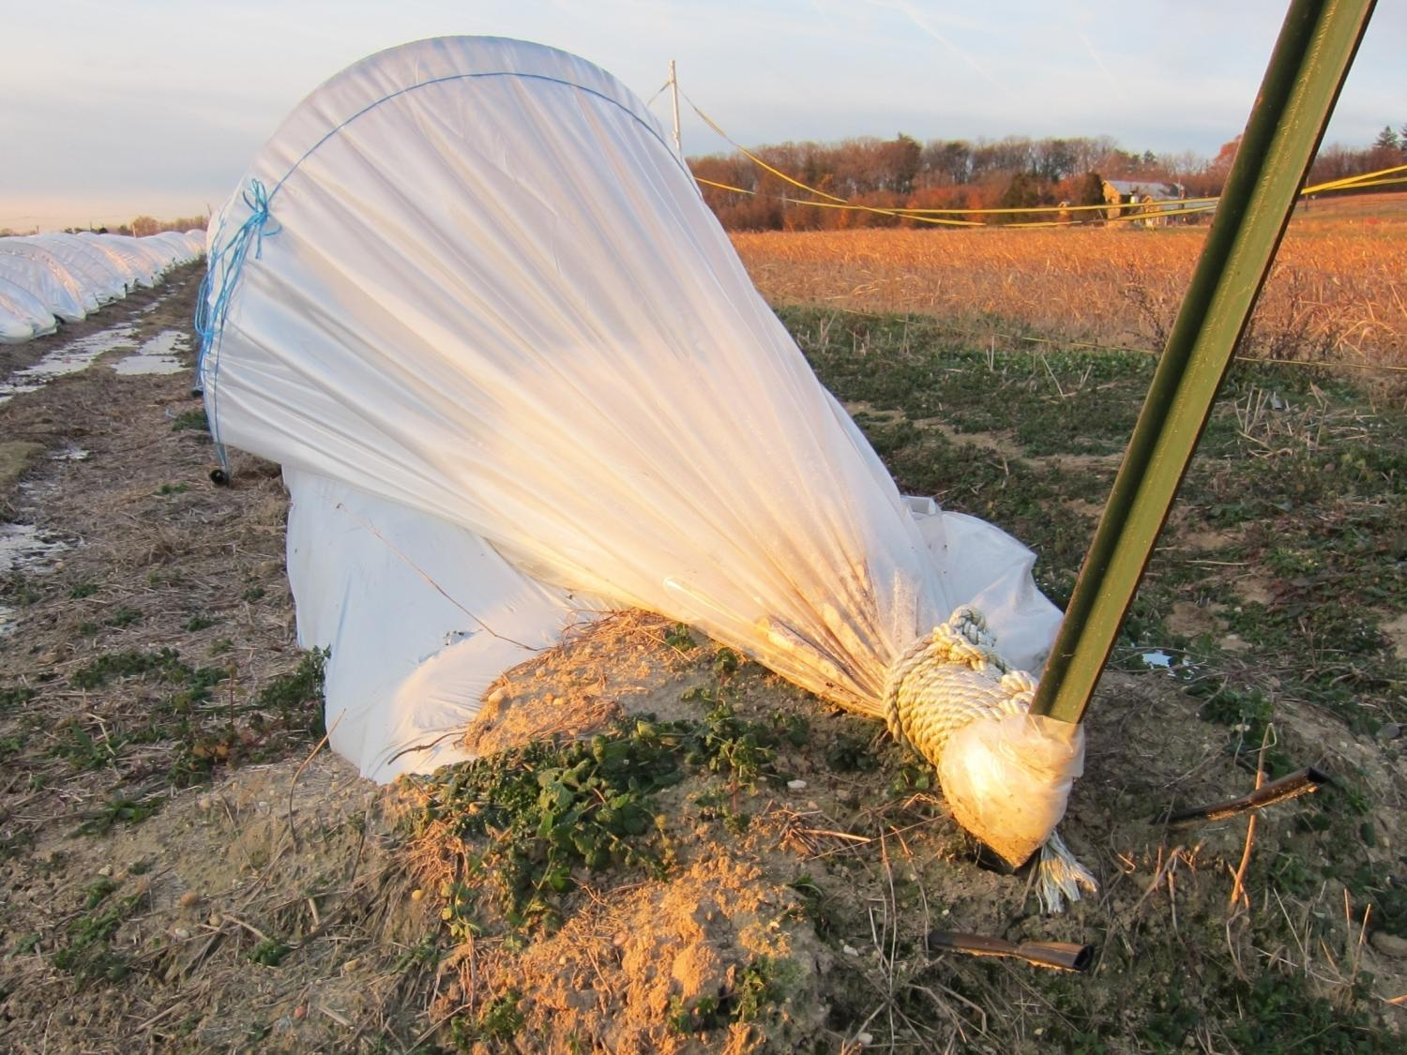
Notes:
Attach the sheeting to both t-posts before raising the sheeting. This is how the ends of the tunnel look when finished, but at this step, your plastic should be laying on the ground next to the tunnel. Walk down the length of the bed on the side with the sheeting laying on the ground and at each hoop, unhook the twine loop from the stopper, raise it up over the sheeting, pull it a little towards you and then under the sheeting, then hook it over the stopper again. Now the sheeting is loosely attached to the tunnel.

Slide 46
Twine and “stoppers”
Notes:
At his point, go to the side of the tunnel opposite of the side that the sheeting is laying on. reach over and pull the sheeting up over the first hoop then the next, down the full length of the tunnel. See how the bailing twine is already holding the sheeting in place because of the earlier steps! Adjust the sheeting so the center fold is centered above the tunnel hoops lengthwise down the bed.
Then on the side of the tunnel where you placed all the knots to be tightened, one loop at a time, tighten the loops so that the twine isn’t flopping around but also isn’t any more than a little snug (this also takes practice). Secure the end of twine that made the loop so the loop cannot loosen. I wrap it around one side of the loop but I don’t pull it all the way through in case I want to adjust the tension later.

Slide 47
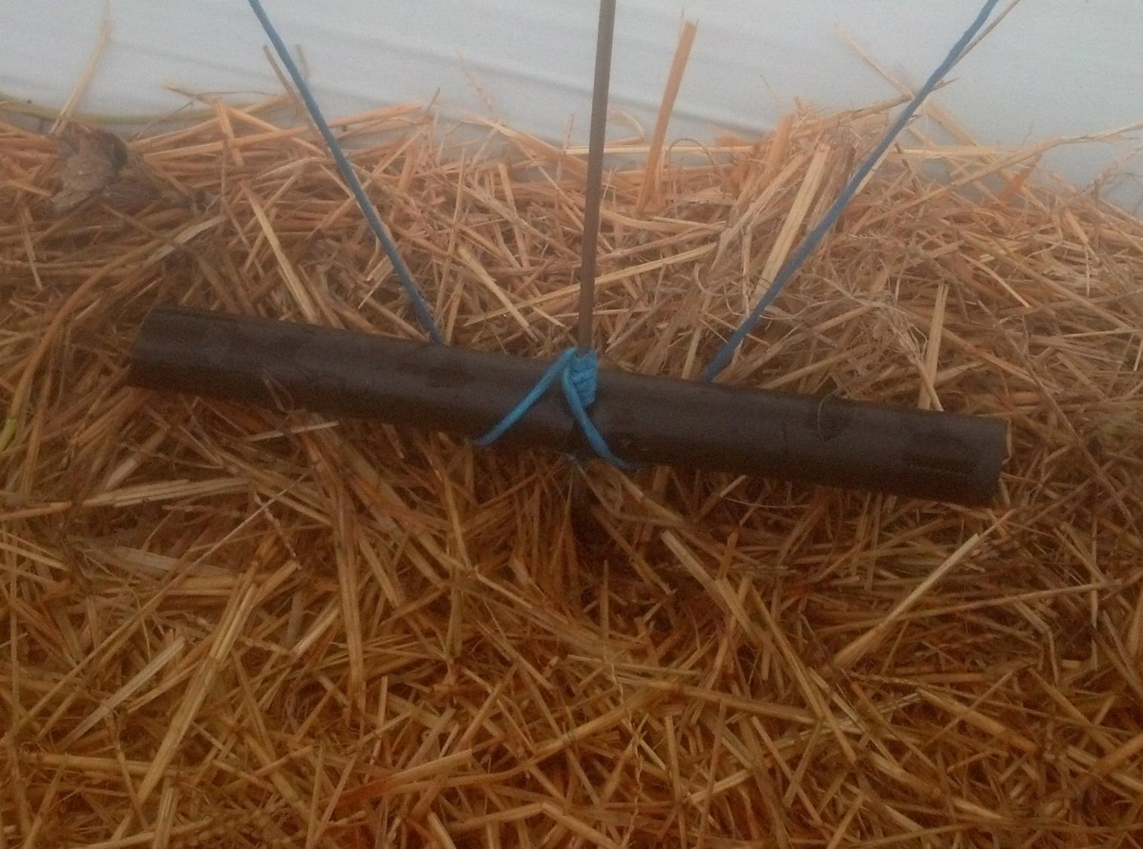
Notes:
Then on the side of the tunnel opposite of where the twine hoop knots are placed, lift hoop and stopper up just a couple of inches and twist the stopper, string and all, 180 degrees. Then loop the twine forward towards you and around one end of that stopper. Repeat for the other end of the stopper. Your result should look like this. Repeat for all hoops on that side. Then repeat for the other side. Now your loops should be really tight across each hoop.

Slide 48
Stabilizing piece of twine holds this piece of twine in position
Keep the hoop in the loop
Notes:
In 2012, I added another idea to keep the hoops positioned between the baling twine. This is important, because when the hoops flop outside the twine the tension on the plastic is lost and then the wind can get them. I keep working to improve the tunnels so they flex in the wind but don’t come apart. The other advantage of this step is realized when it’s time to take apart the tunnels. In disassembling the tunnels, first the twine loops are loosened from the stoppers, then all the twine can be manually pulled off or mechanically pulled off in one big bundle, because these ties at the top connect each twine loop to its neighbor. So much nicer than picking up hundreds of pieces!

Slide 49
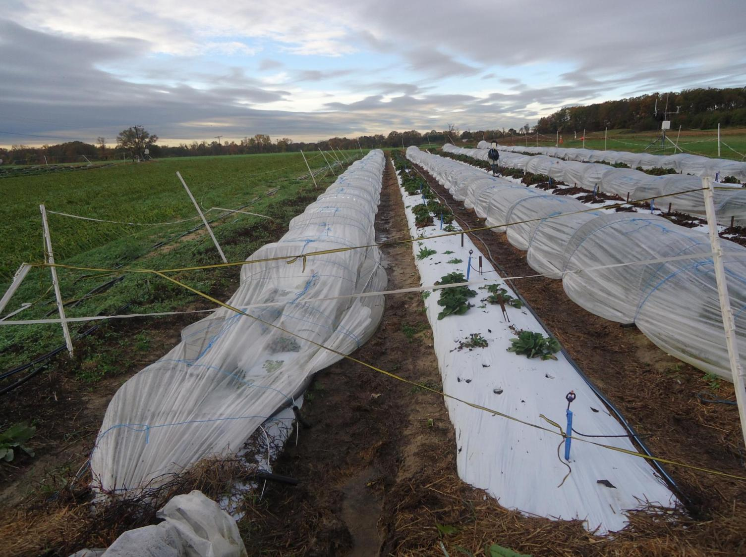
Notes:
This is the kind of damage I got with 3/16 inch steel from Hurricane Sandy. No such damage with ¼ inch steel.

Slide 50
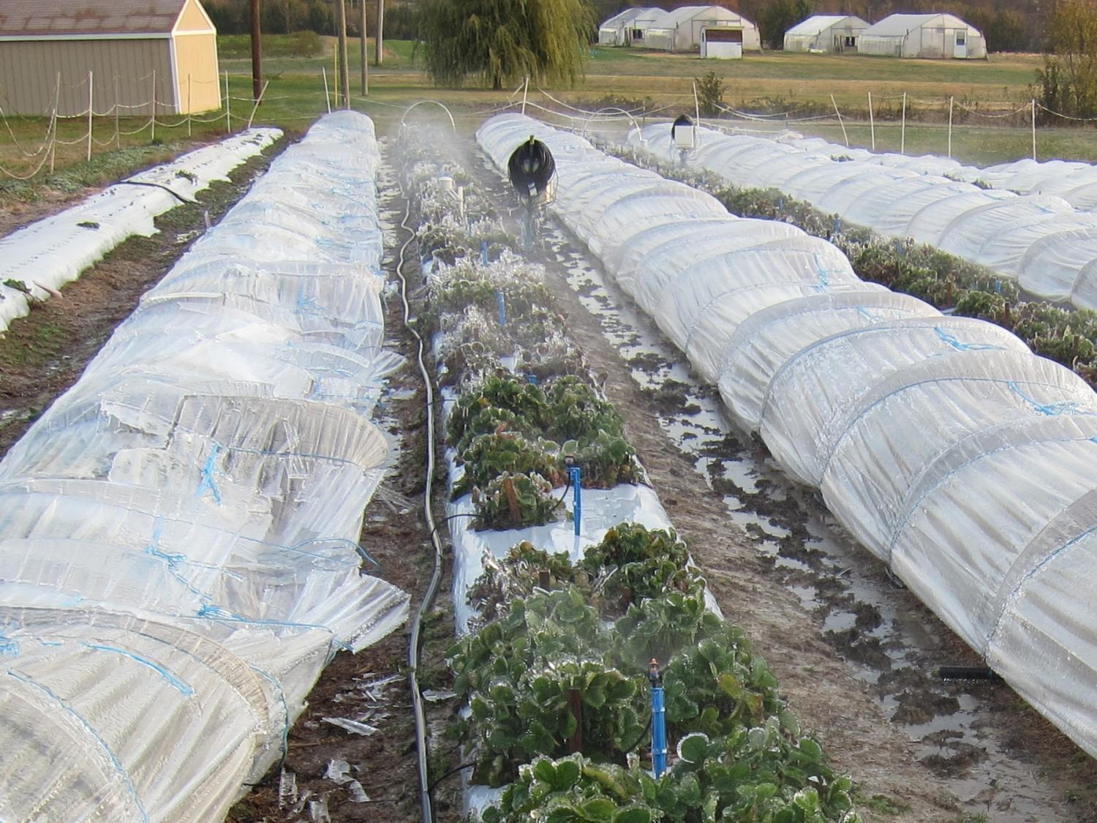
Notes:
Likewise with a simulated ice storm. They look messy but pop up and are fine with a little adjustment. But this is the 3/16 inch steel.

Slide 51
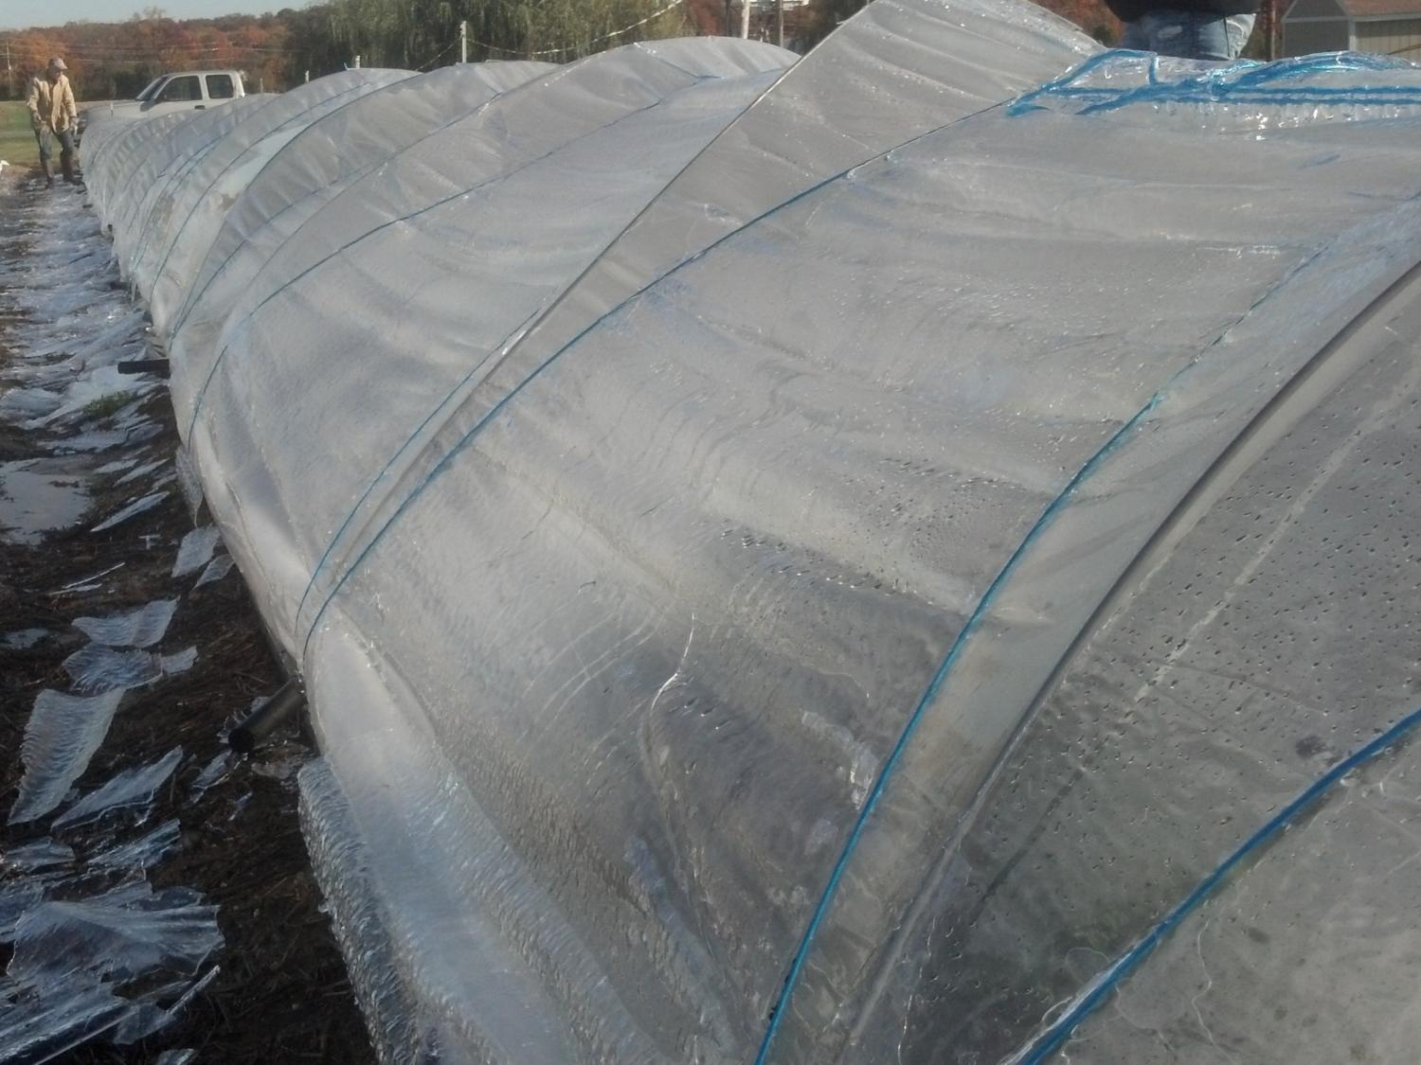
Notes:
3/16 inch steel but with the added support of the bailing twine down the center, looped at each hoop and tied to the t-posts…

Slide 52
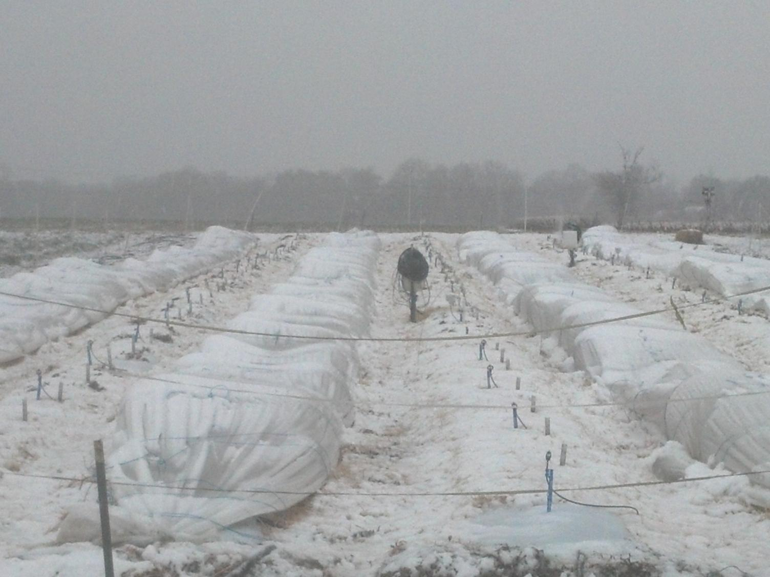
Notes:
Snow on tunnels 2012-2013. This was 3/16 inch steel.

Slide 53
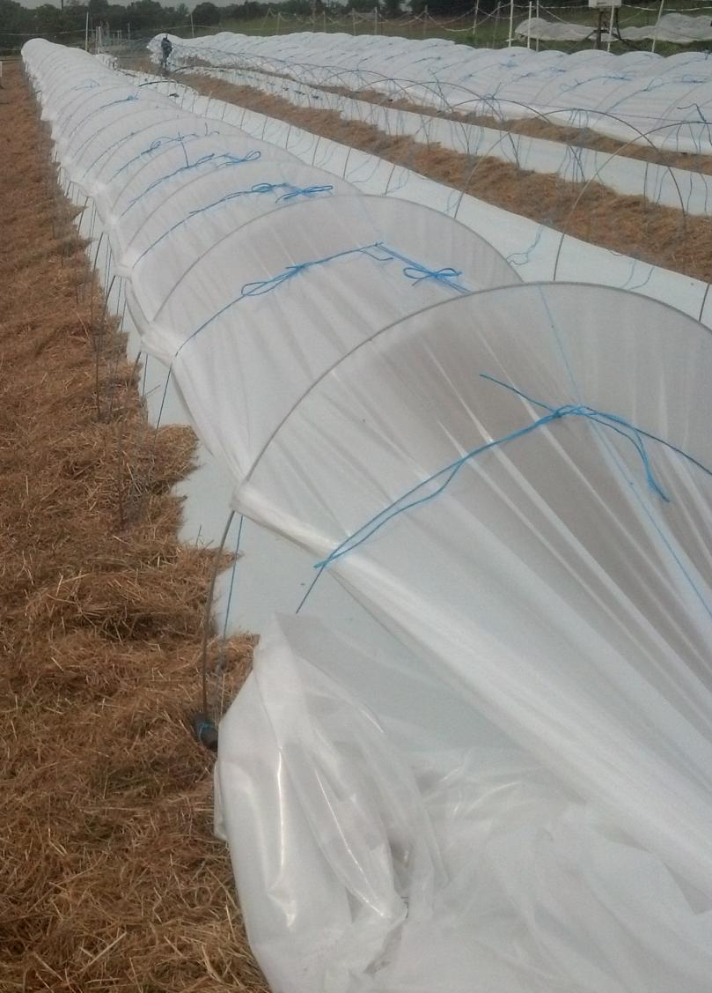
Significant modifications
1/4” steel better than 3/16”
Bailing twine across tunnel top
Tighten at each hoop and not length of tunnel
Stoppers added before hoops are set
Stabilizing twine bows between loops
Method of wrapping the bailing twine around the stopper
Notes:
Use of ¼ inch steel was the most significant structural improvement so far.

Slide 54
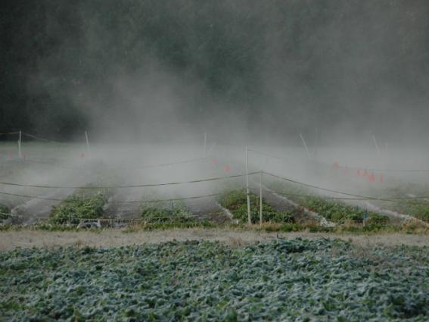
Frost protection
Notes:
To really extend the season, some kind of frost protection is needed. The methods we use are pretty complicated because we have both constant pressure… like at your kitchen sink… and an automated control system that turns on misters under the tunnels at 34F and off again at 36F. The misters are under the tunnels every 10 ft. We use this same system in our open fields on short-day types in combination with rainbirds. You can see frost in the picture but not inside the fields with the mist. It got below 32F outside the field but the mist kept the field above 32F and the rainbirds never came on. This saves a lot of water use – it works like this about half the frost nights in open fields. The system is solar-powered.

Slide 55
Air temperatures mid-November:
Black = inside low-tunnels.
Pink = open bed next to low-tunnels.
70’s
50’s
~34F
Seconds of frost protection with misters under tunnels:
15-minute intervals
6minutes
Notes:
They work even better under the tunnels, usually just pulsing on an off for a couple of minutes every 15 minutes, and I saw absolutely no frost damage. The top chart shows the air temperatures inside (black) and outside the tunnels (pink). Note the way the misters kept the temperature steady at around 34 degrees on these two frost nights of 24F and 26F. Note also how nice and warm it got inside the tunnels in the day in November. The bottom graph shows how little time the water was on each night. In any 15-minute interval, the misters were on no more than 6 minutes these two nights. This really saves a lot of water. The lowest temperature so far was 22F outside the tunnels, and we saw no frost damage inside the tunnels. I am really hoping that some company makes a user-friendly version of this, because it has been valuable to us in the open fields as well as in the tunnels. They can control temperatures under the tunnels down to 16F, but so much water on the plants causes the fruit to swell and burst.

Slide 56
Notes:
I haven’t tried row covers, but I think they are an option that someone should do research on… or try on farm if you already have experience with row covers.

Slide 57
Notes:
We also need machinery a little like this but for our larger tunnels. Please encourage someone to make and sell these.

Slide 58
http://www.duboisag.com/en/tunnel-flex-retractable-low-tunnel-system.html
Notes:
There are lots of ways to make low tunnels. I first saw these the winter of 2011.

Slide 59
University of Minnesota 2012
Notes:
Then Steve Poppe at the University of Minnesota tried them in 2012 after hearing a talk I presented.

Slide 60
Cornell University 2013
Notes:
Cornell University is having excellent results with them too.

Slide 61
University of Arkansas 2014
Notes:
Those constructed at the University of Arkansas in 2014 really illustrate the diversity with which the tunnels can be designed. Conduit was cheaper for them than stainless steel.

Slide 62
Johnny’s Selected Seeds
Notes:
And forms are sold to help you bend conduit to a uniform shape.

Slide 63
Standard
IR diffusing
IR blocking
IR diffusing
Standard
IR blocking
Notes:
The plastic sheeting results in fruit of much better quality in July and August. We think this may be because the tunnel sheeting filters out stressful IR light and allows the strawberries below to tolerate our hot summers. So we’re experimenting with different plastic types that filter out more levels of IR light. The different light transmission properties are obvious in this photograph.

Slide 64
Photosynthetically Active Radiation (PAR)
(400-700nm)
UV (10-400nm)
Infrared (700-1,000 nm)
Standard “clear” plastic
TES plastic (IR diffusing)
TempCool plastic (IR blocking)
Dr. Craig Daughtry, USDA-ARS Beltsville MD
Notes:
Unfortunately there are differences in how much Photosynthetically Active Radiation (PAR) is getting through. It seems the standard clear plastic worked best in this first year of comparing the three sheeting types, but it was such a strange year with a cold wet spring and planting delayed from the desired March two months (May planting). I am looking forward to next year’s data. For now, I can feel comfortable advising the use of “clear plastic sheeting.”

Slide 65
Weekly low-tunnel strawberry yield (g/plant)
2013 – year of planting
Notes:
I also am very excited about preliminary results from breeding for dayneutrals and testing the selections under the low tunnels. Though my selections so far are not large or firm enough, both flavor and yield are superior to dayneutral cultivars originating from the west coast… so I have high hopes for the future of this system for east-coast growers.

Slide 66
Notes:
See how the yield is good but the size isn’t quite there? Give me time though!

